Slide 1



ENVIRONMENT IN HUMANITARIAN ACTION (EHA) TRAINING
Module 1:
Introduction to Environment in Humanitarian Action
Name of Facilitator:
Venue:
Date:

Slide 2

Module Outline
0
4
Humanitarian standards, guidance and principles
0
1
Module Learning Outcomes
Importance of integrating environmental considerations
0
5
0
2
Relationship between environment and humanitarian action
0
6
OCHA/UNEP Joint Environment Unit
0
3
EHA principles and objectives
07
Case studies and best practices
Notes:
2

Slide 3

0
1
Module Learning Outcomes

Slide 4
By the end of this module, you should be able to:
Understand foundational concepts of environmental considerations in humanitarian action.
Integrate key humanitarian standards and principles into environmental considerations.
Articulate the importance of environmental sustainability in humanitarian contexts.
Identify and access resources and tools offered by the OCHA/UNEP Joint Environment Unit to enhance environmental integration.
Apply insights from case studies and best practices to improve the environmental sustainability of humanitarian operations.
Notes:
4

Slide 5

0
2
Session 1: Relationship between environment and humanitarian action

Slide 6
INTRODUCTION
0
1
0
2
0
3
0
4
Humanitarian action can both positively and negatively impact the environment.
Humanitarian actions and environmental factors have a bidirectional relationship
Climate change intensifies many environmental challenges and vice versa.
Environmental factors directly influence the scope and need for humanitarian assistance.

Slide 7


Impact of Humanitarian Action on the Environment
Refugee camps:
Large influxes of displaced people lead to deforestation, water pollution, and waste management issues.
Conflict situations:
Military activities can destroy habitats and cause pollution.

Slide 8
Impact of Humanitarian Action on the Environment
0
1
0
2
0
3
Disasters:
Temporary shelters after disasters can degrade the environment if not managed sustainably.
Resource extraction:
Crises may drive unsustainable resource extraction, leading to long-term damage.
Water and sanitation:
Emergency interventions can contaminate water sources if not properly planned.

Slide 9
Environmental Impact on Humanitarian Action
Disasters
Climate change
Environmental events like hurricanes or earthquakes create immediate humanitarian crises.
Rising temperatures exacerbate food and water insecurity, causing displacement and the need for aid.

Slide 10
Environmental Impact on Humanitarian Action
Resource scarcity
Environmental degradation
Pollution
Lack of water or arable land drives conflict and displacement.
Ecosystem destruction increases vulnerability to disasters.
Health crises caused by pollution (e.g., oil spills) displace communities and require humanitarian responses.

Slide 11

0
3
Session 2: EHA principles and objectives

Slide 12



EHA Principles
  EHA principles focus on minimizing environmental impacts while promoting sustainability and resilience.
  These principles guide humanitarian interventions to be environmentally responsible.
  They are rooted in international environmental law and general environmental principles relevant to humanitarian action.

Slide 13
Core EHA Principles
Precautionary Principle
Prevention Principle
Rectification at Source
Sustainability and Intergenerational Equity
Cumulative Impacts
Polluter Pays
Public Participation
Integration Principle
Notes:
13

Slide 14
EHA Objectives
Reducing immediate environmental effects of interventions.
Core principles guide environmentally responsible humanitarian actions.
EHA objectives focus on minimizing impact, promoting sustainability, and integrating environmental considerations into all phases.
Using biodegradable materials for temporary shelters to reduce plastic waste.
Integrating long-term sustainable methods in humanitarian actions.
Implementing water-saving technologies in camps.
Making environmental factors central in project design and execution.
Conducting environmental screenings or full EIAs for construction projects.
Strengthening community ability to cope with environmental shocks.
Training local communities in sustainable farming practices.
Ensure accountability and participation

Slide 15

0
4
Session 3: Humanitarian standards, guidance and principles

Slide 16


Why Humanitarian Standards?
  Humanitarian standards ensure ethical, effective, and respectful actions.
  Integrating these standards ensures interventions are sustainable and environmentally responsible.
  Protects the dignity and rights of affected populations while minimizing environmental harm.

Slide 17
Key Humanitarian Standards
  Ensures interventions do not cause additional harm to the environment or communities.
  Prevents unintended negative consequences that could worsen suffering or damage the environment.
  Real-world application: Avoiding harmful chemicals in agricultural support programs to prevent soil and water contamination.
  Nine commitments ensuring humanitarian support respect rights and dignity.
  Includes Commitment 4 (prevent environmental harm) and Commitment 9 (responsible resource management).
  Real-world application: Conducting environmental impact assessments and integrating sustainable practices during humanitarian operations

Slide 18
Key Humanitarian Standards
0
1
0
4
Do no Harm
The Sphere Standards
IASC Guidance/ Inclusion of Persons with Disabilities (IASC Guidelines)
Core Humanitarian Standard on Quality and Accountability (CHS)
0
2
0
5
Climate and Environment Charter for Humanitarian Organisations
0
3
Accountability to Affected People/Population (AAP)
0
6

Slide 19
Key Humanitarian Standards
Integrating humanitarian standards is critical for environmentally responsible actions.
'Do No Harm', CHS, AAP, Sphere Standards, and IASC Guidance help organizations minimize environmental impacts.

Slide 20

0
5
Session 4: Importance of integrating environmental considerations

Slide 21

Why Environmental Considerations?
Integrating environmental considerations ensures interventions are effective and sustainable.
Helps protect natural resources, reduce degradation, and enhance community resilience.
Aligns humanitarian actions with broader goals of sustainability and climate resilience.

Slide 22
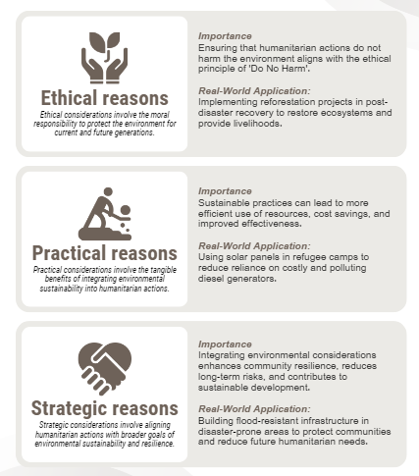
Importance of Environment in Humanitarian Action

Slide 23

0
6
Session 5: OCHA/UNEP Joint Environment Unit

Slide 24
  The JEU is a partnership between UNEP and OCHA addressing environmental dimensions of emergencies.
  Founded in 1994, housed within OCHA’s Emergency Services Branch, Geneva.
  Provides impartial advice, mobilizes partners, and coordinates international efforts.
  Supports long-term rehabilitation and ensures a smooth transition from emergency response to recovery.
  Key services include rapid environmental assessments, technical support, capacity building, and specialized tools.
  JEU has responded to over 200 missions in nearly 100 countries, tackling natural hazards, accidents, and complex crises.
JEU

Slide 25
JEU Key Services Offered
0
1
0
2
0
3
0
4
Conducts assessments to identify environmental risks in emergencies and provides mitigation advice.
Enhances environmental knowledge and skills of humanitarian actors through training and resources.
Provides direct field support, including waste management, pollution control, and sustainable resource use.
Improves collaboration between environmental and humanitarian actors for streamlined environmental management.

Slide 26
JEU Key Tools and Resources
Flash Environmental Assessment Tool (FEAT)
Environmental Emergencies Guidelines
EHA Connect
NEAT+ (Nexus Environmental Assessment Tool)
Rapid tool for identifying environmental risks in early emergency stages.
Used in initial disaster response operations for quick environmental assessments.
Practical advice on managing environmental emergencies.
Used by field teams to guide environmental aspects of emergency response.
Digital platform offering resources for integrating environmental considerations in humanitarian action.
Access to best practices, case studies, and guidance on environmental integration.
Screening tool for environmental risk assessments in humanitarian projects.
Used by humanitarian actors to evaluate environmental impacts of planned activities.

Slide 27

  Contact points: Direct contact through JEU focal points for rapid mobilization of expertise during emergencies.
  Contact details available on the Environmental Emergencies Centre (EEC) platform.
  EHA Connect and Environmental Emergencies Centre provide access to resources and training.
  Humanitarian actors can register online and access resources anytime to enhance preparedness.
How to Reach JEU

Slide 28

0
7
Session 6: Case studies and best practices

Slide 29
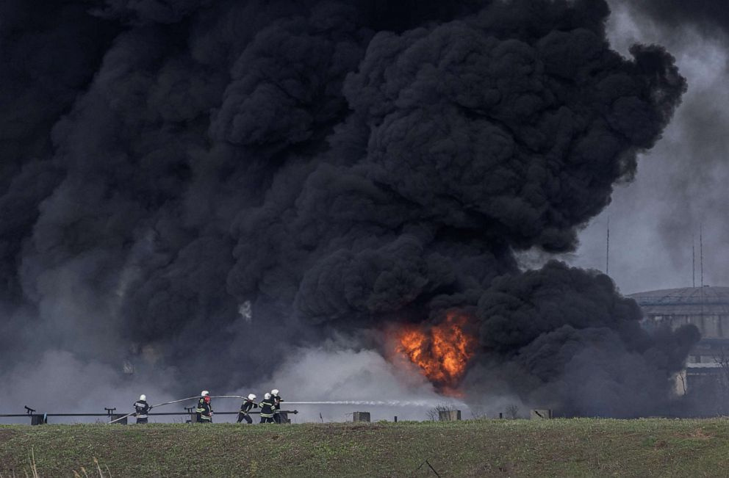
Case Study – Ukraine Conflict
  Context: Environmental damage due to military activities and destruction of industrial sites.
  Environmental challenge: Pollution from damaged industrial sites, habitat destruction, and increased pressure on natural resources.
  Humanitarian response: Environmental impact assessments, remediation measures, sustainable resource management.
  Lessons learned: Early environmental impact assessments and collaboration between humanitarian and environmental organizations are key to mitigating damage.
Source: ABC News/Reuters
Notes:
29

Slide 30
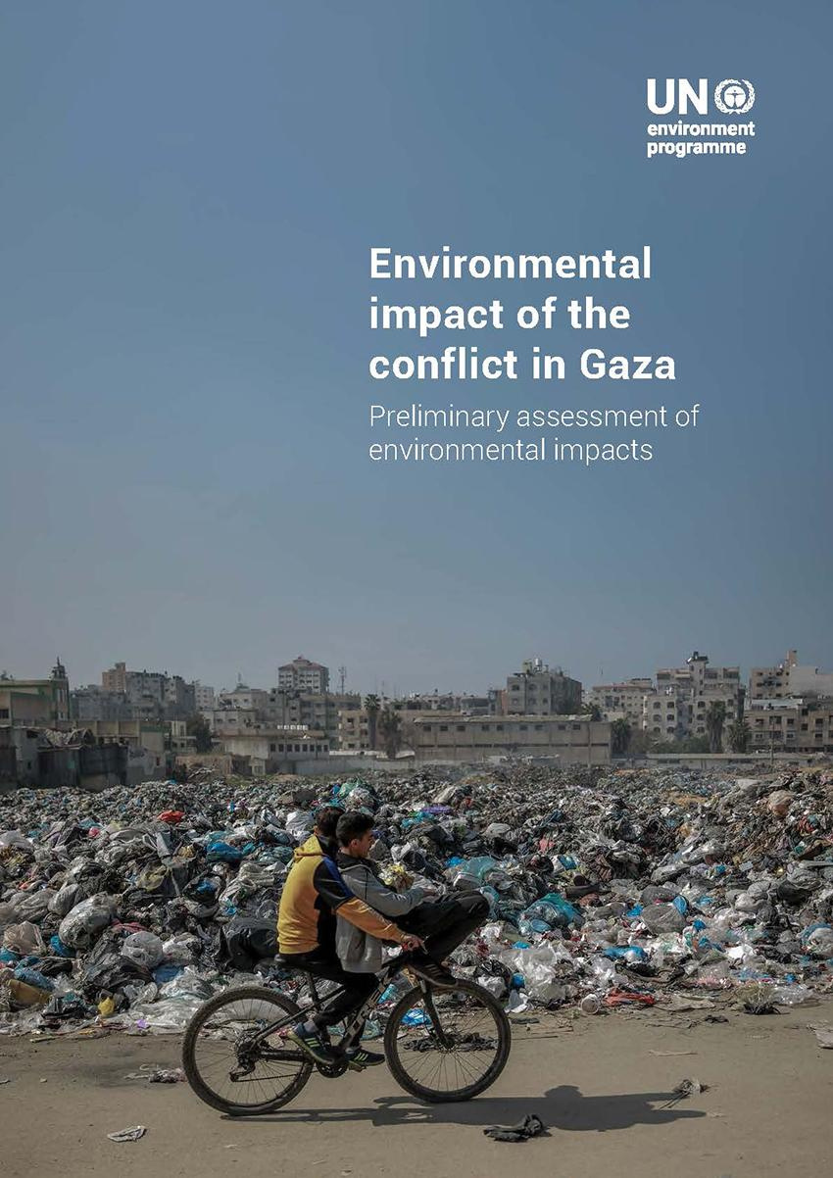

Case Study – Gaza Conflict
  Context: Waste management issues and pollution in a densely populated conflict area.
  Environmental challenge: Accumulation of waste, water contamination, and air pollution due to conflict and blockades.
  Humanitarian response: Waste segregation and recycling programs, alternative waste treatment technologies, community engagement.
  Lessons learned: Community involvement in waste management and innovative waste treatment solutions can mitigate environmental impacts even in conflict zones.
Source: ABC News/Reuters
Notes:
30

Slide 31
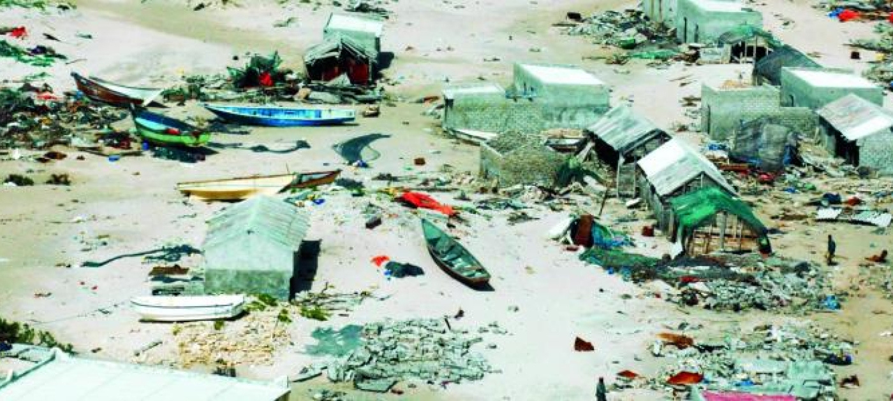
Case Study – Environmental Challenges in Somalia
  Context: Severe drought, deforestation, and land degradation exacerbated by conflict and displacement.
  Environmental challenge: Water scarcity, soil erosion, loss of biodiversity, unsustainable agricultural practices.
  Humanitarian response: Rainwater harvesting, sustainable agricultural practices, reforestation efforts.
  Lessons learned: Integrating environmental sustainability into humanitarian interventions can enhance resilience and reduce risks in the long term.
Source: UNEP
Notes:
31

Slide 32
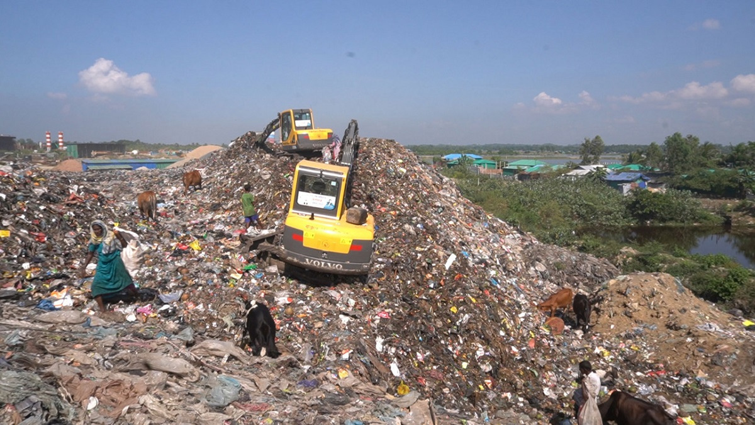
Case Study – Cox’s Bazar Rohingya Refugee Crisis
  Context: Influx of refugees causing significant strain on the local environment.
  Environmental challenge: Deforestation for firewood, overuse of water resources, inadequate waste management.
  Humanitarian response: Reforestation programs, sustainable water management, community-based conservation initiatives.
  Lessons learned: Involving both refugees and host communities in sustainable resource management ensures effective conservation and reduces environmental degradation.
Source: UNDP
Notes:
32

Slide 33

Case Study – Resource Conflicts in Lake Chad
  Context: Shrinking lake causing resource conflicts affecting millions in surrounding countries.
  Environmental challenge: Water scarcity, competition over natural resources, displacement caused by environmental degradation.
  Humanitarian response: Resource-sharing agreements, sustainable livelihoods programs, conflict resolution mechanisms.
  Lessons learned: Addressing environmental drivers of conflict and promoting collaborative resource management leads to peaceful coexistence and reduces displacement.
Source: WFP
Notes:
33

Slide 34
Key Take Aways
  The interconnectedness of environment and humanitarian action:
    The environment and humanitarian actions are closely linked, with each having the potential to impact the other positively or negatively. Integrating environmental considerations into humanitarian responses ensures that interventions do not exacerbate existing environmental challenges.
  Principles of Environmental Humanitarian Action:
    Understanding and applying core EHA principles, such as prevention, precaution, and sustainability, are essential for minimizing negative environmental impacts and promoting long-term resilience in humanitarian operations.
  Importance of humanitarian standards and environmental responsibility:
    Key standards and principles, including the Core Humanitarian Standard, 'Do No Harm,' and Sphere Standards, guide environmentally responsible humanitarian actions. Integrating these standards ensures that humanitarian interventions are ethical, effective, and sustainable.
  Ethical, practical, and strategic benefits of environmental integration:
    Incorporating environmental considerations into humanitarian action aligns with ethical obligations, enhances operational effectiveness, and supports long-term strategic goals of community resilience and sustainability.
  Real-world applications and lessons learned:
    Case studies from various contexts (e.g., Ukraine, Gaza, Somalia) illustrate the importance of integrating environmental considerations in humanitarian settings.

Slide 35
Key Take Aways
  Link to climate change:
    While this module introduces the connection between environmental factors and humanitarian action, a deeper exploration of climate change impacts and responses is covered in Module 5. This linkage highlights the broader context of environmental sustainability within humanitarian interventions.
  Community engagement and public participation:
    Effective EHA requires the involvement of affected populations in decision-making processes. This approach enhances transparency, accountability, and the relevance of humanitarian actions, ensuring that interventions meet both community needs and environmental standards.
  Application of standards in different humanitarian scenarios:
    Practical exercises and scenario-based discussions help participants apply the learned principles and standards, preparing them to implement environmentally responsible actions in real-world humanitarian contexts.
  Role of the JEU:
    The OCHA/UNEP Joint Environment Unit plays a critical role in providing rapid environmental screening and assessments, technical support, and capacity building for humanitarian actors, enhancing the environmental sustainability of emergency responses

Slide 36
Thank you
Any Questions?

