Slide 1



ENVIRONMENT IN HUMANITARIAN ACTION (EHA) TRAINING
Module 10:
Managing Environmental Impacts of Humanitarian Supply Chain
Name of Facilitator:
Venue:
Date:
Notes:
1

Slide 2

Module Outline
0
1
0
2
0
3
0
4
Introduction to supply chain environmental impacts
Strategic supply chain planning for environmental sustainability
Future trends and innovations
Case studies and best practices
Notes:
2

Slide 3

0
1
Module Learning Outcomes

Slide 4
By the end of this module, you should be able to:
Analyze the environmental impacts of procurement, transportation, storage, and disposal activities within humanitarian operations.
Develop and apply sustainable supply chain management strategies that incorporate principles of green logistics, sustainable procurement, and resource efficiency.
Implement advanced practices in energy management, sustainable warehousing, and facilities management to minimize the environmental footprint of supply chain activities.
Evaluate the potential impact of emerging trends, innovations, and technologies on the sustainability of humanitarian supply chains.
Integrate reverse logistics and end-of-life management strategies to promote circular economy practices in humanitarian contexts.
Learn from real-world case studies and best practices, applying lessons learned to enhance the sustainability and efficiency of their own supply chain operations.
Notes:
4

Slide 5

0
2
Session 1: Introduction to supply chain environmental impacts

Slide 6
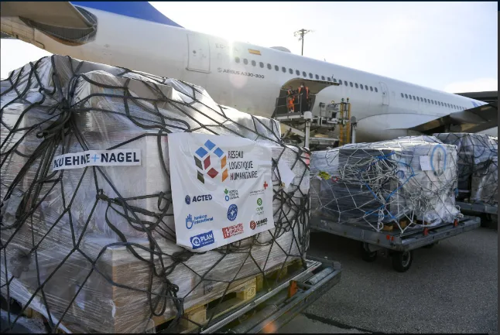
Introduction
  Humanitarian supply chains play a critical role in delivering aid to beneficiaries but can contribute to environmental degradation if not managed sustainably.
  By implementing sustainable practices, humanitarian organizations can reduce emissions, conserve resources, and enhance operational efficiency.
  Each component of the supply chain—planning, sourcing, production, distribution, return/disposal—has environmental impacts that need mitigation.
Source: Plan International
Notes:
6

Slide 7




Humanitarian Supply Chain Components and Environmental Impacts
Planning: Involves forecasting needs, managing donations, and optimizing logistics to minimize waste.
Environmental impacts: Inefficient planning can lead to excess inventory, overuse of airfreight (high carbon footprint), and wasted resources.
Real-world application: Thoughtful planning minimizes waste by reducing overstock and optimizing transport, leading to fewer emissions.
Benefits from the Environment: Reduces unnecessary emissions and resource use by choosing less carbon-intensive transport modes.

Slide 8




Humanitarian Supply Chain Components and Environmental Impacts
Sourcing/Procurement: The process of selecting and acquiring goods and services needed for humanitarian aid, focusing on responsible procurement.
Environmental impacts: Unsustainable sourcing can lead to deforestation, biodiversity loss, and increased carbon emissions from long-distance transportation.
Real-world application: Local sourcing and sustainable procurement minimize the environmental footprint and ensure resources are responsibly sourced.
Benefits from the environment: Helps preserve natural ecosystems and reduces the need for long-haul transportation, lowering emissions.

Slide 9

Humanitarian Supply Chain Components and Environmental Impacts
Production: Refers to the creation or assembly of goods, such as food kits or emergency shelters, customized for local contexts.
Environmental impacts: High energy consumption, pollution, and waste if production processes are not environmentally managed.
Real-world application: Environmentally responsible production supports local economies, uses less energy, and produces minimal waste.
Benefits from the environment: Reduces overall energy use and minimizes pollution, benefiting local environments and communities.

Slide 10



Humanitarian Supply Chain Components and Environmental Impacts
Distribution (Includes Transportation, Warehousing, Last-mile delivery):
Transportation: Movement of goods from suppliers to storage or distribution points.
Warehousing/storage: Storing goods efficiently in energy-efficient facilities.
Last-mile delivery: Final delivery to affected populations, often in challenging environments.
Environmental impacts: Transportation emits high levels of carbon dioxide, especially if using trucks or planes. Warehousing uses significant energy, and inefficient routing in last-mile delivery increases fuel consumption.
Real-world application: Optimizing transport routes, using energy-efficient warehouses, and employing low-carbon transportation options reduces emissions and fuel consumption.
Benefits from the environment: Preserves local ecosystems by minimizing air pollution and conserving fuel resources.

Slide 11


Humanitarian Supply Chain Components and Environmental Impacts
Return/Disposal (Includes Reverse logistics): Managing unsold, unused, or expired goods, including recycling or environmentally responsible disposal.
Reverse Logistics: Processes involved in returning goods for disposal, recycling, or repurposing, ensuring a closed-loop supply chain.
Environmental impacts: Improper disposal of packaging and expired items leads to pollution and health risks.
Real-world application: Responsible recycling, composting, and proper waste disposal protect the environment and ensure the safety of communities.
Benefits from the environment: Reduces pollution and supports waste management systems, promoting healthier ecosystems.

Slide 12
Key Principles of Sustainable Supply Chain Management
Resource Efficiency: Using resources efficiently to minimize waste and the environmental footprint.
    Responsibility: Managed by the buying organization through inventory management and operational practices that conserve resources.
    Real-world application: Inventory management tools help reduce overstock, minimizing waste in aid distribution.
Green Procurement: Prioritizing environmentally friendly products and services to reduce the carbon footprint of procurement.
    Responsibility: The buying organization sets environmental procurement standards, and suppliers comply.
    Real-world application: Prioritizing suppliers with green certifications reduces emissions and supports eco-friendly supply chains.
Energy Management: Implementing energy-efficient practices in supply chain activities to reduce energy consumption and greenhouse gas emissions.
    Responsibility: Managed by the buying organization, integrating energy-efficient technologies into logistics and storage operations.
    Real-world application: Installing solar panels in warehouses cuts down on electricity use, promoting sustainability in storage.

Slide 13
Key Principles of Sustainable Supply Chain Management
Waste Reduction: Reducing waste generation through recycling, reuse, and better inventory management.
    Responsibility: Organizations implement waste reduction practices, and suppliers provide sustainable packaging and materials.
    Real-world application: Adopting refillable containers and sustainable packaging reduces plastic waste and pollution.
Livelihood Generation and Local Market Support: Promoting sustainable livelihoods by supporting local economies and using eco-friendly, locally sourced materials.
    Responsibility: The buying organization promotes local market integration, while suppliers offer locally sourced, sustainable products.
    Real-world application: Collaborating with local artisans to produce eco-friendly shelter materials supports local livelihoods and reduces environmental impact.
Life Cycle Assessment (LCA): Evaluating the environmental impact of a product from creation to disposal, guiding sustainable procurement decisions.
    Responsibility: Conducted by the buying organization, with suppliers providing data on environmental impacts.
    Real-world application: Comparing biodegradable versus conventional plastic packaging helps select the option with the least environmental impact.

Slide 14

0
3
Session 2: Strategic supply chain planning for environmental sustainability

Slide 15
Introduction
Hierarchy of actions in humanitarian supply chains: Inspired by the 5R principles, humanitarian supply chain planning should emphasize reducing waste and emissions as the priority, followed by reusing, recycling, recovering value, and redesigning processes to be eco-friendly.
High-impact strategies: Prioritize actions with the greatest environmental benefits, such as reducing reliance on air freight and shifting to greener modes of transport like sea and rail.
Strategic supply chain planning: Focus on holistic planning, resource allocation, and contingency strategies that minimize environmental impacts while ensuring efficient operations.
Green logistics: Fuel-efficient vehicles, route optimization, and multi-modal transport reduce the environmental footprint of transport activities.
Sustainable procurement: Environmental criteria should guide the selection of suppliers to promote responsible sourcing of goods and services.
Sustainable warehousing: Emphasize energy efficiency, waste minimization, and the use of renewable energy in storage facilities.
Reverse logistics and end-of-life management: Ensure responsible handling, recycling, or disposal of materials after use, minimizing waste and environmental harm.
Innovations: Electric vehicles, sustainable packaging, and IoT technologies are transforming the supply chain, reducing emissions and improving operational resilience.

Slide 16
Steps in strategic supply chain planning
Demand forecasting
  Predicting the needs for goods and services to minimize overproduction and waste.
  Real-world application: Forecasting shelter materials in disaster zones ensures efficient use of resources and avoids unnecessary overstock.
Resource allocation
  Assigning resources to maximize efficiency and minimize environmental impact.
  Real-world application: Allocating resources to prefer sea freight over air freight where possible, reducing carbon emissions.
Contingency planning
  Preparing for unexpected disruptions such as disasters or transportation delays.
  Real-world application: Developing alternative transport routes during seasonal floods prevents delays and minimizes environmental harm.

Slide 17
Steps in strategic supply chain planning
Supplier evaluation
  Assessing suppliers based on their environmental performance and sustainability practices.
  Real-world application: Partnering with suppliers that use eco-friendly materials reduces the overall environmental footprint of the supply chain.
Monitoring and reporting
  Tracking supply chain performance to ensure alignment with environmental goals.
  Real-world application: Implementing tracking systems to monitor fuel consumption and optimize delivery routes to reduce emissions.

Slide 18
Steps in strategic supply chain planning
Risk management
  Identifying and mitigating environmental risks in the supply chain.
  Real-world application: Establishing protocols for managing hazardous materials during transportation and storage to avoid environmental contamination.
Collaboration and stakeholder engagement
  Engaging with stakeholders, including suppliers, local communities, and environmental groups, to align supply chain practices with sustainability goals.
  Real-world application: Engaging local communities to co-develop supply chain practices that are both environmentally and culturally sensitive.

Slide 19
Sustainable procurement strategies
Green supplier selection
  Choosing suppliers based on environmental performance and sustainability practices.
  Real-world application: Sourcing from suppliers using eco-friendly packaging and materials.
  Responsibility: The buying organization sets environmental criteria for supplier selection.
Ethical sourcing
  Ensuring goods are sourced from suppliers adhering to ethical labor and sustainability standards.
  Real-world application: Procuring fair-trade certified products for humanitarian aid.
  Responsibility: The buying organization enforces ethical sourcing criteria.

Slide 20
Sustainable procurement strategies
Local sourcing
  Procuring goods and services from local suppliers to reduce transportation emissions and support local economies.
  Real-world application: Using local suppliers for shelter materials to minimize carbon emissions.
  Responsibility: The buying organization prioritizes local suppliers.
Sustainable contracting
  Including environmental and sustainability criteria in supplier contracts.
  Real-world application: Contracts mandating reduced packaging and eco-friendly delivery practices.
  Responsibility: The buying organization ensures environmental clauses are part of contracts.

Slide 21
Sustainable procurement strategies
Green procurement policies
  Developing procurement policies focused on eco-friendly products and practices.
  Real-world application: Mandating biodegradable packaging for all procurements.
  Responsibility: The buying organization implements green procurement policies.
Life cycle costing
  Evaluating the environmental and financial costs of goods over their lifecycle.
  Real-world application: Choosing energy-efficient equipment that reduces costs over time.
  Responsibility: The buying organization considers long-term environmental impacts when making procurement decisions.

Slide 22
Sustainable procurement strategies
Supplier development
  Working with suppliers to improve their environmental practices.
  Real-world application: Providing training to suppliers on sustainable farming methods.
  Responsibility: The buying organization supports suppliers in meeting environmental goals.
Environmental product specifications
  Defining environmental criteria for products, such as recyclable or eco-friendly materials.
  Real-world application: Specifying recycled materials for shelter construction in contracts.
  Responsibility: The buying organization sets product specifications.

Slide 23
Sustainable procurement strategies
Sustainable materials
  Prioritizing materials with lower environmental impacts, like recycled or renewable materials.
  Real-world application: Using biodegradable plastics or recycled materials in humanitarian logistics.
  Responsibility: The buying organization sources sustainable materials.

Slide 24
Green freight and transport strategies
Electric vehicles (EVs)
  Using EVs to reduce emissions during logistics operations.
  Real-world application: Using electric vehicles for urban deliveries of aid supplies.
Biogas-powered vehicles
  Using biogas as a renewable fuel to reduce carbon emissions.
  Real-world application: Employing biogas-powered trucks for logistics in rural areas
Route optimization
  Using software to optimize transport routes, reducing travel time and fuel consumption.
  Real-world application: Implementing route optimization to minimize emissions during aid deliveries.

Slide 25
Green freight and transport strategies
Multi-modal transport
  Combining various transport modes (road, rail, sea) to reduce environmental impact.
  Real-world application: Using rail and sea transport for long-distance aid delivery, minimizing air freight.
Hybrid vehicles
  Using hybrid vehicles to reduce fuel consumption and emissions.
  Real-world application: Deploying hybrid trucks for last-mile deliveries in remote areas.
Telemetry and telematics
  Monitoring vehicle performance and driver behavior to optimize fuel efficiency.
  Real-world application: Tracking fleet fuel usage and adjusting driving practices to lower emissions.

Slide 26
Green freight and transport strategies
Cargo consolidation
  Grouping shipments to optimize vehicle loads, reducing the number of trips and fuel usage.
  Real-world application: Consolidating shipments to minimize trips in delivering medical supplies.
Reduce freight and mileage
  Minimizing the distance goods travel and overall freight volume to reduce the carbon footprint.
  Real-world application: Prioritizing local sourcing to minimize transportation needs.
Shift from air to sea freight
  Switching from air freight (high emissions) to sea freight (lower emissions).
  Real-world application: Using sea freight for non-urgent supplies to reduce emissions.

Slide 27
Sustainable warehousing and facilities management practices
Energy-efficient lighting
Installing LED lighting to reduce energy use in warehouses.
Real-world application: Retrofitting storage facilities with LED lighting systems to lower energy consumption.
Use of renewable energy
Powering warehouse operations with solar panels or wind energy.
Real-world application: Installing solar panels on warehouse roofs to power operations sustainably.
Sustainable building materials
Using recycled or sustainable materials for warehouse construction.
Real-world application: Building warehouses with recycled steel and reclaimed wood to minimize the environmental footprint.

Slide 28
Sustainable warehousing and facilities management practices
Water conservation
  Implementing water-saving technologies such as rainwater harvesting.
  Real-world application: Installing rainwater harvesting systems in warehouses to reduce reliance on municipal water supplies.
Waste management programs
  Establishing recycling programs and responsible waste disposal systems.
  Real-world application: Recycling packaging materials like cardboard, plastics, and metals in warehouses.
Green warehouse design
  Designing warehouses for energy efficiency, utilizing natural light and ventilation.
  Real-world application: Constructing warehouses with skylights and energy-efficient HVAC systems.

Slide 29
Sustainable warehousing and facilities management practices
Sustainable inventory management
  Using practices that minimize waste and optimize the use of resources.
  Real-world application: Implementing just-in-time inventory to reduce waste from expired goods.
Temperature standards in warehouses
  Optimizing temperature settings to reduce energy use while preserving goods.
  Real-world application: Using energy-efficient temperature controls to preserve goods in storage with minimal energy.
Energy-efficient HVAC systems
  Installing energy-efficient heating, ventilation, and air conditioning systems.
  Real-world application: Using energy-efficient HVAC systems to maintain optimal warehouse temperatures.

Slide 30
Sustainable warehousing and facilities management practices
Low-emission refrigeration
  Using refrigeration systems that emit fewer greenhouse gases and use eco-friendly refrigerants.
  Real-world application: Installing low-emission refrigeration for perishable aid supplies.
Biodiversity-friendly landscaping
  Incorporating native plants and sustainable landscaping around facilities.
  Real-world application: Using native plants for warehouse landscaping to reduce water use and support biodiversity.

Slide 31
Reverse logistics and end-of-life management strategies
0
1
0
2
0
3
Product return
Managing the return of unused or surplus goods to suppliers for reuse or resale.
Real-world application: Returning surplus medical supplies for redistribution in other humanitarian settings.
Safe disposal of hazardous materials
Ensuring hazardous materials like batteries are disposed of in environmentally friendly ways.
Real-world application: Safely disposing of expired or damaged medical supplies.
Recycling programs
Collecting and recycling materials like packaging and outdated equipment.
Real-world application: Implementing recycling systems for plastic packaging in disaster response.

Slide 32
Reverse logistics and end-of-life management strategies
Remanufacturing and refurbishment
Extending the lifecycle of products through refurbishment and remanufacturing.
Real-world application: Refurbishing medical equipment to prolong its use in humanitarian settings.
Asset recovery
Recovering and reusing assets like vehicles and equipment after operations.
Real-world application: Refurbishing temporary shelters for use in future disaster response efforts.

Slide 33
Reverse logistics and end-of-life management strategies
Decommissioning and site rehabilitation
Safely dismantling and rehabilitating sites after the end of operations.
Real-world application: Dismantling temporary shelters and restoring land used for refugee camps to its natural state.
Donation of surplus goods
Donating surplus goods to other organizations or communities, reducing waste.
Real-world application: Donating surplus food supplies to local communities post-operation to avoid spoilage.

Slide 34

0
4
Session 3: Future trends and innovations

Slide 35
Introduction
Future trends and innovations are continuously shaping the landscape of sustainable supply chain management.
Keeping up with these changes helps organizations remain competitive and sustainable.
Innovations in technology, materials, and processes can significantly reduce the environmental footprint of supply chain activities and improve efficiency.
Global environmental policies, such as the Paris Agreement, and emerging regulations on sustainability and carbon emissions are influencing trends in supply chain management.
These frameworks emphasize the urgency of adopting sustainable practices.
While these innovations offer benefits, there are challenges to implementation, including technology costs, resistance to change, and the need for new skills in supply chain management.

Slide 36
Digital technologies
01
02
03
Big data analytics
Analyzing vast datasets to gain insights into supply chain performance and identify areas for improvement.
Potential Impact: Improves decision-making, increases transparency, and boosts efficiency in supply chain management through better resource allocation and risk management.
Blockchain technology
Integrating blockchain to ensure transparent, secure transactions within the supply chain.
Potential Impact: Provides enhanced traceability, reduces fraud, and builds trust among stakeholders, leading to more secure and reliable processes.
Digitalization and IoT
Utilizing digital tools and the Internet of Things (IoT) for real-time tracking, predictive maintenance, and automated inventory management.
Potential Impact: Enhances supply chain visibility and efficiency, leading to more responsive and streamlined humanitarian operations.

Slide 37
Sustainable practices
0
1
0
2
0
3
Advanced recycling technologies
Leveraging technologies like chemical recycling to break down complex materials into reusable resources.
Potential Impact: Increases recycling rates, reduces waste, and recovers valuable materials, preventing environmental pollution.
Green supply chain financing
Accessing capital tied to sustainability performance, encouraging the adoption of eco-friendly practices.
Potential Impact: Incentivizes organizations to scale sustainable practices, ensuring long-term environmental and financial sustainability.
Electric and autonomous vehicles
Utilizing electric and autonomous vehicles for logistics and transportation operations.
Potential Impact: Reduces emissions, lowers fuel costs, and enhances efficiency, making logistics more sustainable and resilient.

Slide 38
Operational efficiency
01
02
Artificial intelligence (AI)
Applying AI to optimize demand forecasting, inventory management, and logistics planning.
Potential Impact: Increases operational efficiency, reduces waste, and improves decision-making, enhancing supply chain sustainability.
Telemetry and telematics
Using advanced vehicle tracking systems to optimize fuel consumption and reduce emissions.
Potential Impact: Lowers operational costs, improves fuel management, and enhances environmental performance across fleets.

Slide 39
Innovative manufacturing
3D printing
    Utilizing 3D printing for on-demand production, particularly in remote areas.
    Potential Impact: Reduces the need for extensive inventory storage, minimizes transportation costs, and decreases waste.
Decentralized manufacturing
    Localizing manufacturing processes to reduce transportation emissions and increase responsiveness to community needs.
    Potential Impact: Reduces carbon footprint, strengthens community resilience, and enhances adaptability in disaster-prone regions.

Slide 40
Resource management
Supply chain resilience
Innovations aimed at enhancing the resilience of supply chains, especially in response to climate change and disasters.
Potential Impact: Ensures continuity and adaptation through real-time data and risk management, making supply chains more robust against disruptions.

Slide 41

0
5
Session 4: Case studies and best practices

Slide 42
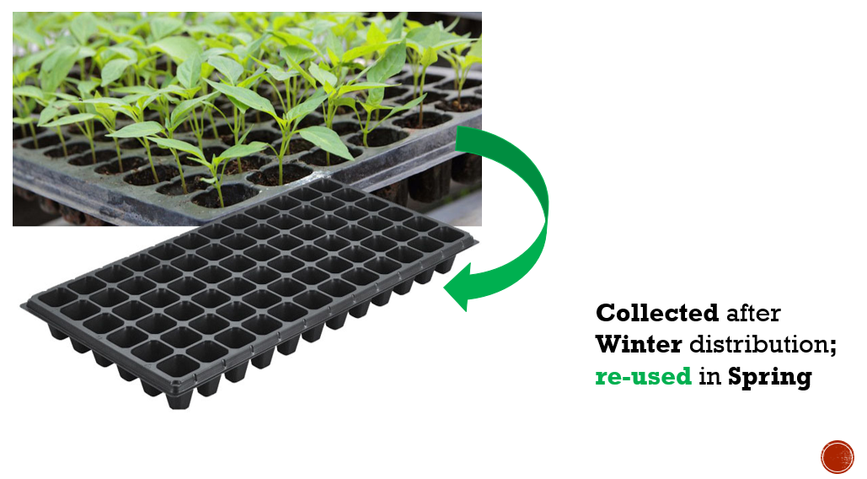
Green logistics in Lebanon
Context: Implementation of sustainable logistics practices by the International Committee of the Red Cross (ICRC) after the Beirut port blast.
Environmental Challenge: Reducing waste and the environmental impact of logistics operations.
Humanitarian Response: The ICRC provided seedlings in plastic trays to affected communities and later collected and returned the trays for reuse, supporting home-scale planting initiatives.
Lessons Learned: Reusing materials can significantly reduce waste and operational costs while promoting sustainability. Collaborating with suppliers to establish a return system for used trays can effectively manage resources and minimize environmental impact.
Source: ICRC
Notes:
42

Slide 43
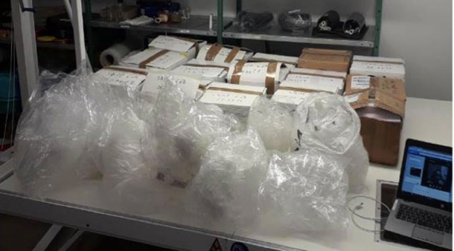
Context: Distribution of NFIs (Non-Food Items) in prisons by the International Committee of the Red Cross (ICRC).
Environmental Challenge: Reducing plastic waste in packaging.
Humanitarian Response: Replaced plastic bags with cardboard, saving more than 60,000 plastic bags annually.
Lessons Learned: Simple changes in packaging materials can lead to significant reductions in plastic waste, providing both environmental and operational benefits.
Sustainable procurement in Afghanistan

Slide 44
Waste reduction in Kenya
  Context: Shelter Box's response to the ban on single-use plastics in Kenya.
  Environmental Challenge: Complying with local environmental regulations and reducing plastic waste.
  Humanitarian Response: Removed unnecessary plastic packaging from six frequently used relief items, avoiding nearly 200,000 plastic bags since 2021.
  Lessons Learned: Engaging suppliers in sustainability discussions can lead to significant waste reduction and compliance with local regulations, demonstrating the importance of aligning procurement strategies with environmental policies.

Slide 45
Fleet optimization in Costa Rica
  Context: The Costa Rica Red Cross, the largest ambulance service provider in Costa Rica, optimizing fleet usage.
  Environmental Challenge: Reducing fuel consumption and carbon emissions.
  Humanitarian Response: Implemented vehicle tracking systems, introduced fuel-efficient driving techniques, and optimized routes.
  Lessons Learned: Efficient fleet management can result in substantial cost savings and reductions in carbon emissions, highlighting the value of integrating sustainability into transportation logistics.

Slide 46

Reusable packaging in Sierra Leone
  Context: EMERGENCY's initiative to switch from plastic bags to reusable plastic boxes for pharmaceutical products in Sierra Leone.
  Environmental Challenge: Reducing plastic waste from packaging.
  Humanitarian Response: Transitioned to heavy-duty plastic containers for distributing health commodities, reducing the use of more than 1 million plastic bags over 10 years.
  Lessons Learned: The switch to reusable containers demonstrates how a small initial investment can lead to significant environmental benefits and long-term cost savings, showcasing the importance of sustainable packaging solutions in humanitarian supply chains.
Source: EMERGENCY/USAID
Notes:
46

Slide 47
From Waste to Wheels: Transforming Jordan’s Transport Sector
  Context: Jordan’s initiative to convert its waste collection fleet to bio-CNG.
  Environmental Challenge: Reducing greenhouse gas emissions from transport and managing landfill methane emissions.
  Humanitarian Response: Although not directly within a humanitarian context, this project addresses key environmental and public health challenges by improving air quality, reducing greenhouse gas emissions, and managing waste. It indirectly supports humanitarian principles by enhancing the resilience of urban communities, including vulnerable populations.
  Lessons Learned: Collaborative, context-specific approaches that leverage local resources can successfully address environmental and public health challenges, demonstrating the potential for broader application in enhancing urban resilience and supporting sustainable development in humanitarian settings.

Slide 48
Key takeaways
Understanding impacts: Humanitarian supply chains, including procurement and transport, have significant environmental impacts. Reducing these impacts is essential for sustainability.
Sustainable principles: Key principles like resource efficiency, green procurement, and waste reduction are crucial for minimizing environmental footprints.
Strategic planning: Effective planning across all supply chain stages ensures waste reduction and optimizes environmental performance.
Sustainable procurement: Choosing suppliers based on environmental and ethical practices supports long-term sustainability goals.
Innovative transport strategies: Electric vehicles, biogas-powered vehicles, and route optimization reduce emissions and improve efficiency.

Slide 49
Key takeaways
Sustainable warehousing: Renewable energy, efficient lighting, and water conservation help minimize the environmental impact of warehousing.
Reverse logistics: Reusing, recycling, and responsible disposal promote a circular economy, reducing waste.
Future trends: Digitalization, IoT, and blockchain are transforming supply chains, enhancing sustainability and transparency.
Case studies: Real-world examples from Lebanon, Afghanistan, and Kenya show successful sustainable supply chain practices.
Application in humanitarian contexts: Sustainable strategies reduce environmental impacts and improve efficiency, requiring ongoing learning and collaboration.

Slide 50
Thank you
Any Questions?

