Slide 1



ENVIRONMENT IN HUMANITARIAN ACTION (EHA) TRAINING
Module 2:
Environmental Screening in Humanitarian Action
Name of Facilitator:
Venue:
Date:

Slide 2
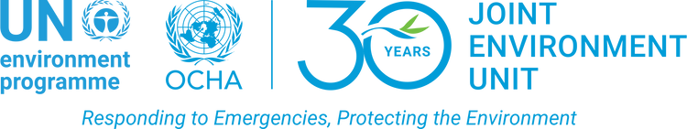
Module Outline
0
1
Introduction to environmental screening and risk assessment
0
4
Developing and prioritizing mitigation strategies
0
2
Methodologies and tools for environmental screening
0
5
Case studies and practical exercises
0
3
Steps in conducting an environmental screening
Notes:
2

Slide 3

0
1
Module Learning Outcomes

Slide 4
By the end of this module, you should be able to:
Understand the foundational concepts and principles of environmental screening and risk assessment within the context of humanitarian operations, including the differences between screening and full Environmental Impact Assessments (EIA).
Be able to use relevant tools and methodologies such as NEAT+ and REA to conduct thorough environmental screenings, ensuring that potential environmental risks are identified early in the project cycle.
Develop and prioritize effective strategies to mitigate environmental risks, incorporating criteria such as efficiency, cost-effectiveness, community acceptability, and compliance with local legislation.
Recognize the importance of integrating environmental considerations into all stages of humanitarian project planning and implementation, ensuring that interventions are both sustainable and minimally harmful to the environment.
Understand the role of local legislation, community involvement, and organizational capacity in conducting environmental screenings, and how these factors influence the success and compliance of humanitarian project
Notes:
4

Slide 5
Session 1: Introduction to environmental screening and risk assessment
0
2

Slide 6



INTRODUCTION
Environmental screening is essential for ensuring sustainable humanitarian actions by evaluating potential environmental consequences.
Environmental screening is a rapid assessment tool that identifies risks and guides project planning, especially in resource-limited settings.
Incorporating environmental considerations during project planning reduces the likelihood of environmental harm and ensures responsible humanitarian interventions.

Slide 7
Importance of Conducting Environmental Screening in Humanitarian Contexts
Identification of Risks
Compliance with Standards
Timely Mitigation
Enables rapid development of strategies to avoid or reduce negative environmental impacts
Quickly identifies potential environmental risks, allowing for early detection and management
Ensures projects meet environmental standards and guidelines, avoiding legal or regulatory issues
Resource Efficiency
Prevention of Long-Term Damage
Community Engagement
Streamlines the process, making it suitable for resource-limited settings, saving time and costs
Focuses on preventing actions that could lead to long-term environmental degradation
Involves local communities in the process, enhancing relevance and acceptability of mitigation strategies.

Slide 8
Overview of Environmental Screening, and EIA
Environmental Impact Assessment (EIA)
  A detailed analysis of a project’s potential environmental impacts, usually required by law.
  When appropriate: For large-scale projects with potentially significant environmental impacts.
  Example: Conducting an EIA for a large infrastructure project to ensure compliance with environmental regulations.
Environmental Screening
  A rapid process to identify, evaluate, and prioritize potential environmental risks in humanitarian interventions.
  When appropriate: Early stages of a humanitarian response, when quick decisions are needed.
  Example: Screening environmental impacts before establishing a temporary shelter in a disaster-affected area.

Slide 9
Differences Between Environmental Screening and EIA
01
02
Timeframe:
Environmental Screening: Quick application, often completed in days or weeks, depending on the project’s complexity.
EIA: Longer process, taking several months due to the in-depth analysis required.
Scope:
Environmental Screening: Focused, rapid assessment of potential environmental risks in specific projects or interventions.
EIA: Comprehensive, detailed analysis of environmental impacts across a wide range of environmental factors.

Slide 10
Differences Between Environmental Screening and EIA
03
04
Application Context:
Environmental Screening: Used in humanitarian contexts where time, resources, and immediate action are critical.
EIA: Mandated for large-scale development projects with significant environmental impacts, like infrastructure projects.
Expertise Required:
Environmental Screening: Can be conducted by trained humanitarian staff using simplified tools and checklists.
EIA: Requires specialized environmental experts, field surveys, and technical evaluations.

Slide 11
Differences Between Environmental Screening and EIA
05
06
Outcome:
Environmental Screening: Provides a rapid overview of key risks, leading to immediate mitigation actions.
EIA: Results in a detailed Environmental Impact Statement (EIS) that guides project approval or rejection.
Regulatory Compliance:
Environmental Screening: May ensure basic compliance with guidelines but is usually not legally required.
EIA: Legally required in many countries, with public consultations and formal reporting processes.

Slide 12
Differences Between Environmental Screening and EIA
07
08
Public Participation:
Environmental Screening: Limited to basic consultations, focused on immediate project impacts.
EIA: Involves extensive public participation, including hearings and consultations to ensure transparency.
Cost:
Environmental Screening: Generally low-cost due to its streamlined nature.
EIA: High cost, reflecting the need for extensive research, expert consultations, and reporting.

Slide 13
Differences Between Environmental Screening and EIA
09
10
Follow-up and Monitoring:
Environmental Screening: May involve informal checks on environmental indicators, depending on available resources.
EIA: Involves formal monitoring with scheduled reviews and reporting to regulatory bodies.
Flexibility:
Environmental Screening: Allows for rapid adjustments based on findings, enabling quick adaptation.
EIA: Less flexible due to its detailed and formalized nature, requiring formal amendments to address changes.

Slide 14

Session 2: Methodologies and tools for environmental screening
0
3

Slide 15



OVERVIEW
Various tools and methodologies are used to conduct environmental assessments, each with unique strengths.
Effective use of these tools enhances sustainability and environmental responsibility in humanitarian interventions, helping prevent negative impacts.
Tools like NEAT+, FEAT, and REA enable rapid assessments, while comprehensive assessments like EIA are required for large-scale projects.

Slide 16
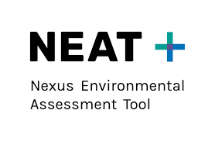
Overview of Environmental Screening and Risk Assessment Tools
NEAT+ (Nexus Environmental Assessment Tool):
  A rapid environmental screening tool for use in both rural and urban humanitarian contexts. It identifies high, medium, and low environmental risks and offers mitigation tips.
  Application: Mainstreaming environmental concerns in humanitarian projects; early identification of risks.
  Example: Applied in planning WASH activities in refugee camps to minimize environmental degradation.
Notes:
16

Slide 17
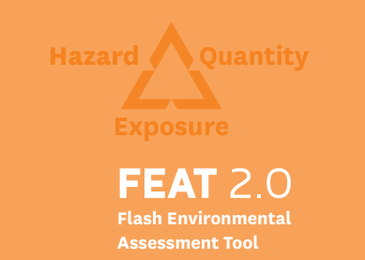
Overview of Environmental Screening and Risk Assessment Tools
FEAT (Flash Environmental Assessment Tool):
  A rapid tool to assess potential environmental hazards, particularly in emergencies involving industrial or chemical hazards.
  Application: Used for initial assessments to guide emergency response interventions.
  Example: Used after an industrial accident to assess the environmental risk of chemical spills in an earthquake-affected area.
Notes:
17

Slide 18
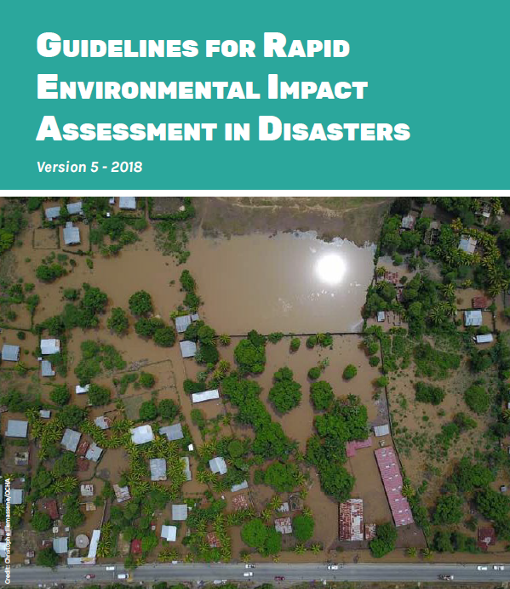


Overview of Environmental Screening and Risk Assessment Tools
REA (Rapid Environmental Impact Assessment):
  A tool to identify, prioritize, and assess environmental impacts in disaster situations.
  Application: Guides environmental action plans and early mitigation responses.
  Example: Conducting a REA after a major flood to assess immediate environmental risks and inform mitigation actions.
Notes:
18

Slide 19

Overview of Environmental Screening and Risk Assessment Tools
EIA (Environmental Impact Assessment):
  A comprehensive process to evaluate environmental consequences of large-scale humanitarian or development projects.
  Application: Required for projects with potentially significant environmental impacts.
  Example: Used for large housing reconstruction projects to assess environmental impacts post-disaster.
Notes:
19

Slide 20
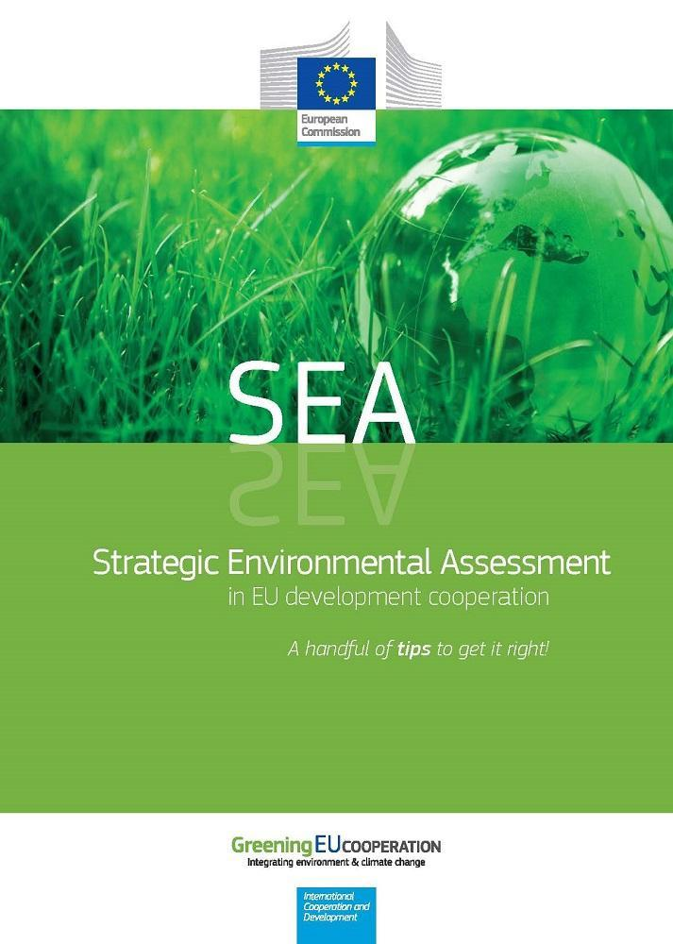
Overview of Environmental Screening and Risk Assessment Tools
SEA (Strategic Environmental Assessment):
  Evaluates the environmental impacts of policies, plans, or programs at a strategic level.
  Application: Integrates environmental considerations into high-level decision-making.
  Example: Conducted during the strategic planning of humanitarian interventions in disaster-prone areas.
Notes:
20

Slide 21
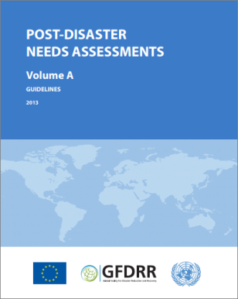
Overview of Environmental Screening and Risk Assessment Tools
PDNA (Post-Disaster Needs Assessment):
  A comprehensive tool that assesses damage, losses, and environmental needs post-disaster, guiding recovery efforts.
  Application: Helps integrate environmental concerns in broader post-disaster recovery strategies.
  Example: Used after a major earthquake to assess environmental damage alongside social and economic impacts.
Notes:
21

Slide 22

Overview of Environmental Screening and Risk Assessment Tools
VEHA (Virtual Environmental and Humanitarian Adviser):
  An online tool designed to help humanitarian actors integrate environmental considerations into response planning, offering sector-specific guidance.
  Application: Provides tailored environmental advice and supports planning across various humanitarian sectors.
  Example: Used in planning water and sanitation interventions in camps to ensure alignment with sustainable practices.
Notes:
22

Slide 23

Overview of Environmental Screening and Risk Assessment Tools
CEDRIG (Climate, Environment, and Disaster Risk Reduction Integration Guidance):
  A tool that supports integrating climate change, environmental risks, and disaster risk reduction into humanitarian and development programs.
  Application: Used for screening strategies and projects for environmental risks, with three levels of assessment: Light, Strategic, and Operational.
  Example: CEDRIG Light used in initial screening of shelter locations for environmental hazards post-flooding.
Notes:
23

Slide 24

Overview of Environmental Screening and Risk Assessment Tools
Environmental Audits:
  A systematic evaluation to ensure compliance with environmental standards during project implementation.
  Application: Monitors ongoing projects and identifies areas for environmental improvement.
  Example: Conducted in long-term refugee camps to ensure compliance with waste management standards.
Notes:
24

Slide 25
Detailed Guidance on Using NEAT+ for Environmental Screening
Activity Modules:
  Assesses environmental impacts of humanitarian activities in shelter, WASH, livelihoods sectors and/or food security.
  Provides specific insights into environmental risks based on activity type.
  Example: Evaluated the environmental impact of shelter construction in an urban refugee camp.
Environmental Sensitivity Module:
  Assesses environmental sensitivity based on factors like vegetation, soil, and socio-economic settings.
  Identifies vulnerabilities in the environment, guiding further analysis.
  Example: Assessed the sensitivity of flood-affected land in a refugee camp.
Notes:
25

Slide 26
Detailed Guidance on Using NEAT+ for Environmental Screening
Automated Reporting:
  Provides automated reports categorizing environmental risks (low, medium, high) and offering tailored recommendations.
  Simplifies the decision-making process, offering clear, actionable insights.
  Example: Used in early emergency responses to ensure environmental concerns are addressed.
Environmental Analysis:
  Combines data from sensitivity and activity modules to produce comprehensive reports with mitigation strategies.
  Guides project managers on mitigation actions to reduce environmental damage.
  Example: Generated a report for camp management suggesting waste management practices.
Notes:
26

Slide 27
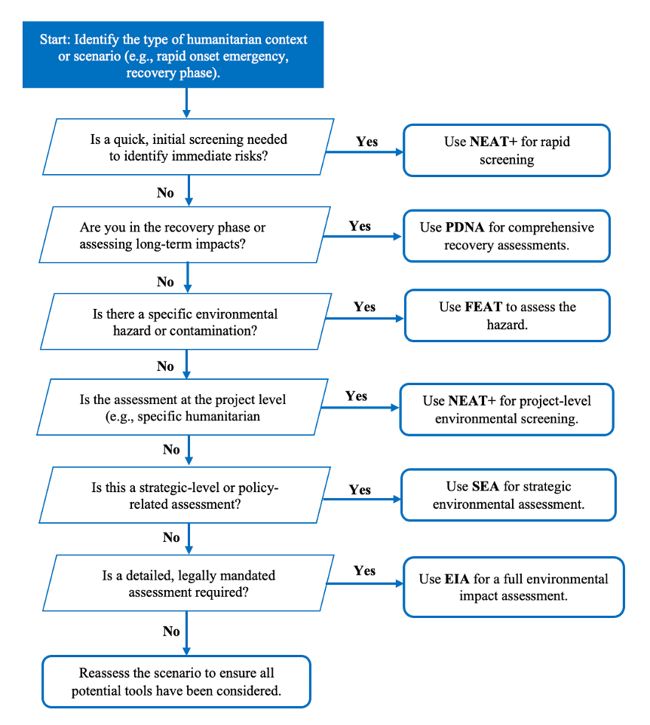
Decision Guide for Selecting Environmental Screening/Assessment Tools
Notes:
27

Slide 28
0
Session 3: Steps in conducting an environmental screening
4

Slide 29
INTRODUCTION
Challenges like limited resources, data scarcity, or lack of community engagement may arise during the process. Flexibility and collaboration are essential to overcome these hurdles and ensure environmental responsibility and sustainability.
Environmental screening is the first crucial step in assessing the potential impacts of humanitarian interventions on the environment.
A systematic screening process ensures early identification of environmental risks, enabling timely and effective mitigation measures.

Slide 30




Steps in Conducting Environmental Screening
1. Initial Scoping
2. Data Collection
3. Legal and Regulatory Review
4. Stakeholder Consultation
Identify the scope, geographic area, and activities to be screened.
Ensures all relevant environmental factors are considered early.
Example: Assess potential deforestation risks in a proposed shelter site.
Gather relevant environmental data, including baseline information on local ecosystems, resources, and potential hazards.
Establishes a foundation for accurate risk assessment.
Example: Collect data on local water sources and soil conditions in flood-prone areas
Review all relevant environmental laws, regulations, and guidelines.
Ensures compliance with legal requirements and responsible stewardship.
Example: Review local water usage laws before starting a WASH project.
Engage with local communities, environmental experts, and stakeholders to gather input.
Incorporates local knowledge, increasing relevance and acceptance of findings.
Example: Hold community meetings to discuss the environmental impact of a WASH project

Slide 31


Steps in Conducting Environmental Screening
5. Environmental Sensitivity Analysis
6. Impact Identification and Evaluation
7. Mitigation Planning
8. Monitoring and Review
9. Reporting
Assess the sensitivity of the local environment using tools like NEAT+ or other methodologies.
Identifies areas where environmental impacts are likely to be most significant.
Example: Use NEAT+ to identify high-risk areas for water contamination and deforestation.
Identify and evaluate potential environmental impacts, both direct and indirect.
Prioritizes environmental risks and informs appropriate mitigation strategies.
Example: Evaluate the impact of waste disposal on local water quality in disaster-affected communities.
Develop a mitigation plan to avoid, minimize, or manage environmental impacts.
Reduces the likelihood of negative outcomes by addressing identified risks.
Example: Plan waste management in refugee camps, including recycling and disposal strategies.
Establish a framework to track the effectiveness of mitigation measures and adapt the plan as necessary.
Ensures mitigation strategies work and allows for adjustments.
Example: Conduct regular water quality testing to ensure waste management is preventing contamination.
Document all findings, including identified risks, mitigation measures, and the monitoring framework.
Ensures transparency and accountability and guides project implementation.
Example: Produce a report outlining the environmental risks and strategies for a shelter project.

Slide 32
Challenges to Environmental Screening
Lack of environmental expertise
Community resistance or lack of engagement
Limited time and resources
Multiple tools and methods
Regulatory and legal constraints
Data scarcity, inaccessibility and inconsistent quality
Political and security challenges
Funding constraints
Technological limitations
Cultural and social barriers
Coordination among multiple stakeholders
Logistical constraints in remote areas
Political interference
Adaptability to climate change

Slide 33

Session 4: Developing and prioritizing mitigation strategies
0
5

Slide 34


Introduction
Developing effective mitigation strategies is crucial for ensuring humanitarian projects do not unintentionally harm the environment or affected communities.
Selection and prioritization of mitigation strategies should be based on factors such as efficiency, cost-effectiveness, community acceptance, compliance with local legislation, and potential co-benefits.
Understanding and complying with local laws and involving communities in the process ensures the long-term success of mitigation strategies.

Slide 35
Identifying and Prioritizing Environmental Risks
Identify environmental risks:
  Use the findings from environmental screening to list the environmental risks associated with the project.
  This step provides clarity on key environmental issues and helps focus mitigation efforts.
Assess severity of risks:
  Evaluate how likely the risks are to occur and the potential impact they might have.
  Prioritize risks based on their severity to address the most critical ones first.
Categorize risks:
  Group risks into categories (e.g., high, medium, low) to streamline the mitigation process.
  Simplifies which risks need urgent action versus those that can be managed over time.

Slide 36
Identifying and Prioritizing Environmental Risks
Consider cumulative impacts:
  Assess how the identified risks interact with other activities or projects in the same area.
  Ensures that you address not just isolated risks but also the combined environmental impacts.
Consider cross-cutting issues:
  Look at how environmental risks might intersect with other concerns like gender, health, or livelihoods.
  Helps ensure that mitigation measures are not only environmentally effective but also socially inclusive.
Involve the community in risk identification:
  Engage local communities to capture their input on environmental risks.
  Incorporating local knowledge ensures risks are accurately identified and mitigation efforts are supported.

Slide 37



Criteria for Selecting and Prioritizing Mitigation Strategies
Efficiency
Cost Effectiveness
Community Acceptance
Compliance with local legislation
Long-term sustainability:
Assess how effectively each mitigation strategy addresses the identified environmental risk.
Ensure the chosen strategy reduces risks within a reasonable timeframe and with available resources.
Compare the cost of the mitigation strategy to the benefits it provides in reducing environmental risks.
Select the most cost-effective option that maximizes environmental protection with minimal expense.
Ensure that the mitigation strategy is culturally acceptable and meets the community's social and economic needs.
Involving local communities in the planning and design of the strategy increases
Confirm that all mitigation strategies align with relevant local, regional, and national laws.
Avoid legal issues by obtaining permits and ensuring all activities follow environmental guidelines.
Consider whether the mitigation strategy will remain effective over time, even after the project ends.
Choose solutions that contribute to long-term environmental resilience and are self-sustaining.

Slide 38


Criteria for Selecting and Prioritizing Mitigation Strategies
Adaptability
Environmental co-benefits
Feasibility
Stakeholder Engagement
Organizational capacity
Assess whether the strategy can be adapted to changing circumstances, such as new data or project needs.
Choose flexible strategies that can evolve as conditions change.
Consider if the strategy provides additional benefits beyond reducing the identified risk, such as improving biodiversity or reducing carbon emissions.
Strategies with multiple benefits are often more attractive and impactful.
Evaluate whether the strategy can realistically be implemented considering local technology, expertise, and infrastructure.
Choose strategies that are practical and achievable within the project’s constraints
Gauge how much involvement from stakeholders is needed to implement the strategy successfully.
Engage local communities, governments, and partner organizations in the implementation process to ensure buy-in.
Ensure the organization has the necessary resources, skills, and infrastructure to carry out the mitigation strategy.
If there are gaps, consider building capacity or partnering with other organizations to implement the strategy.

Slide 39

0
6
Session 5: Case studies and practical exercises

Slide 40




Key Takeaways
Environmental screening allows for rapid identification of risks and timely mitigation in humanitarian interventions.
Screening, ERA, and EIA serve different purposes, ensuring appropriate environmental management for different project scales.
Tools like NEAT+, FEAT, and REA are essential for effective environmental assessments.
The screening process involves scoping, data collection, stakeholder consultation, and mitigation planning.

Slide 41





Key Takeaways
Effective mitigation strategies are based on efficiency, cost-effectiveness, community acceptance, and legal compliance.
Compliance with local legislation and community involvement ensures sustainable and well-supported mitigation strategies.
Challenges like limited resources and data scarcity can be overcome with simplified tools and adaptive approaches.
Real-world examples highlight the successful implementation of screening and mitigation strategies.
Continuous monitoring ensures that mitigation strategies remain effective and adaptable.

Slide 42
Thank you
Any Questions?

