Slide 1



ENVIRONMENT IN HUMANITARIAN ACTION (EHA) TRAINING
Module 4:
Sustainable Water Resource Management in Humanitarian Action
Name of Facilitator:
Venue:
Date:

Slide 2
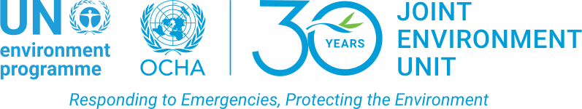
Module Outline
0
1
0
2
0
3
0
4
Introduction to water resource management in humanitarian settings
Techniques for sustainable water management
Challenges and strategic solutions in water resource management
Case studies and practical exercises
Notes:
2

Slide 3

0
1
Module Learning Outcomes

Slide 4
By the end of this module, you should be able to:
Understand the critical importance of water resource management in humanitarian contexts.
Identify and evaluate various water resources.
Analyze the environmental impacts of poor water management.
Apply sustainable water management techniques in emergency settings.
Assess challenges in water resource management.
Explore strategic solutions and best practices for addressing water management challenges.
Engage in case study analysis to identify lessons learned and best practices
Notes:
4

Slide 5

0
2
Session 1: Introduction to water resource management in humanitarian settings

Slide 6
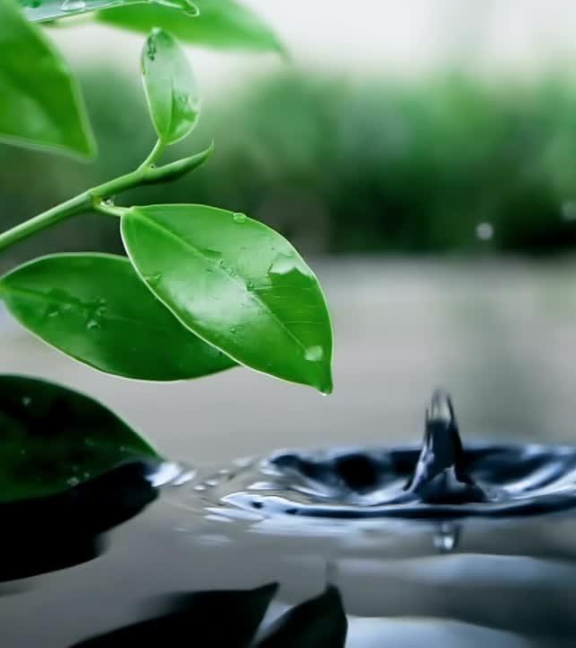
Introduction
  Water resource management is essential for ensuring the health and well-being of affected populations in humanitarian settings.
  Different water sources, such as surface water, groundwater, and rainwater, present unique challenges and opportunities in emergencies.
  Poor water management can lead to severe environmental and health impacts, including the spread of diseases, ecosystem degradation, and exacerbation of climate change effects

Slide 7
Importance of Water Resource Management in Emergencies
Health and Sanitation
    Safe drinking water prevents disease outbreaks and maintains hygiene.
    Impact: Reduces risk of diseases such as cholera, typhoid, and dysentery.
    Example: Providing clean water in cholera-prone areas prevents disease spread.
Environmental Stability
    Proper water management preserves ecosystems.
    Impact: Protects biodiversity and natural resources.
    Example: Managing water during floods reduces soil erosion and preserves wetlands.
Sustainability of Interventions
    Integrated water management ensures long-term resource access.
    Impact: Reduces reliance on emergency water supplies, supports recovery.
    Example: Solar-powered water pumps in drought areas reduce reliance on emergency deliveries.
Protection of Livelihoods
    Water is essential for agriculture and livestock activities
    Impact: Ensures food security and sustains livelihoods
    Example: Providing irrigation prevents displacement during droughts

Slide 8
Importance of Water Resource Management in Emergencies
Social Cohesion and Conflict Prevention
    Equitable water distribution reduces conflict risks.
    Impact: Promotes cooperation between displaced populations and host communities.
    Example: Joint water management committees reduce resource-related tensions.
Support for WASH Programs
    Effective water management underpins WASH (Water, Sanitation, and Hygiene) interventions.
    Impact: Improves public health, reduces the spread of diseases.
    Example: Reliable access to water for handwashing stations in camps reduces communicable diseases.
Adaptation to Climate Change
    Resilient water strategies help communities adapt to climate change.
    Impact: Increases resilience to droughts, floods, and changing weather patterns.
    Example: Implementing rainwater harvesting systems ensures water availability during dry spells.
Economic Impact
    Proper water management reduces the financial burden of operations.
    Impact: Lowers costs and improves efficiency by minimizing reliance on expensive emergency water deliveries.
    Example: Investing in sustainable water infrastructure reduces costs associated with trucking in water.

Slide 9






Suggestions for Additional Modules
Integrated Water Resource Management, Localizing environment, Water Shed Governance and advocacy
Training of Trainers (ToT) on environmental integration in humanitarian contexts.
“We need absolutely and rapidly a glossary of terms! I am an environmental expert and I can tell that people who studied international relations have no idea of what they are talking about!”
Climate resilience, adaptation strategies, and sustainable resource management.
Legal and Regulatory Frameworks for Environmental Protection in Humanitarian Contexts
Focus on practical tools and techniques for implementation rather than purely theoretical knowledge.
Financing for environmental programs and projects.
Notes:
9

Slide 10
Understanding Different Water Resources
Groundwater
    Water stored underground in aquifers.
    Importance: Reliable source when surface water is unavailable.
    Example: Boreholes drilled in drought-affected regions provide a continuous supply.
Surface Water
    Water from rivers, lakes, and reservoirs.
    Importance: Crucial for immediate access in emergencies.
    Example: Utilizing rivers and lakes as primary water sources for affected populations.
Rainwater Harvesting
    Collection and storage of rainwater for later use.
    Importance: Reduces dependency on other water sources.
    Example: Implementing rainwater harvesting systems in areas with seasonal rainfall.
Desalinated Water
    Seawater processed to remove salts and minerals.
    Importance: Provides a vital water source in coastal regions with limited freshwater.
    Example: Desalination plants provide freshwater in drought-affected coastal areas.
Notes:
10

Slide 11
Types of Wastewater
Rainwater/ Stormwater
    Water from rain, snowmelt, and irrigation.
    Impacts: Water bodies contamination with pathogens and heavy metals, soil erosion, and infrastructure damages
    Opportunities: Rainwater harvesting for water usage or irrigation and using NbSs to reduce flooding risks.
Greywater
    Water from generated from washing food, clothes, dishware, and bathing
    Impacts: Water bodies contamination with chemicals and microorganisms, vector-born diseases, and blockage and wastewater drainage system overload.
    Opportunities: Irrigation after treatment, toilet flushing, and external surfaces cleaning.
Blackwater
    Water that contains human waste, typically from toilets.
    Impacts: Water and soil contamination, spread of waterborne diseases, severe odor problems, and emission of Greenhouse Gases.
    Opportunities: Toilet flushing and external surfaces cleaning after treatment and using treated sludge as fertilizer.

Slide 12
Environmental Impact of Poor Water Management
Health Risks
  Contaminated water leads to disease outbreaks.
  Consequences: Increased risk of waterborne diseases such as cholera, typhoid, and dysentery.
  Example: Inadequate sanitation in refugee camps leads to disease outbreaks.
Ecosystem Degradation
  Over-extraction or pollution damages ecosystems.
  Consequences: Long-term damage to biodiversity and agricultural productivity.
  Example: Over-extraction of water from rivers depletes fish populations and disrupts food chains.
Exacerbation of Climate Change Effects
  Poor water management worsens climate impacts like droughts and floods.
  Consequences: Increased vulnerability to extreme weather events.
  Example: Poor water management in drought-prone areas leads to soil degradation and dust storms.
Notes:
12

Slide 13
Environmental Impact of Poor Water Management
Conflict and Social Tensions
  Scarcity of water resources can lead to conflict between communities.
  Consequences: Escalation of violence, displacement, and strain on humanitarian operations.
  Example: Disputes over water access in conflict zones require equitable resource distribution.
Increased Reliance on Emergency Water Supplies
  Poor water management forces reliance on expensive and logistically difficult emergency water shipments.
  Consequences: Higher costs and logistical burdens on humanitarian operations.
  Example: Prolonged need for water trucking to refugee camps strains resources and budgets.
Depletion of Groundwater Resources
  Over-extraction of groundwater leads to the depletion of aquifers.
  Consequences: Long-term impacts include reduced groundwater availability for future generations and the need for more expensive drilling operations.
  Example: Over-reliance on boreholes during emergencies depletes groundwater reserves.
Notes:
13

Slide 14
Environmental Impact of Poor Water Management
Degradation of Water Quality
  Pollution from poor sanitation and industrial waste degrades water quality, making it unsafe for consumption.
  Consequences: Health risks, loss of aquatic life, and spread of pollutants through the food chain.
  Example: Contamination of rivers due to upstream industrial waste forces relocation of communities to avoid health risks.
Loss of Agricultural Productivity
  Insufficient water supply negatively impacts agricultural productivity, leading to food shortages and economic losses.
  Consequences: Reduced food security and increased reliance on food aid.
  Example: Lack of water for irrigation during droughts leads to significant crop losses and food insecurity.
Notes:
14

Slide 15
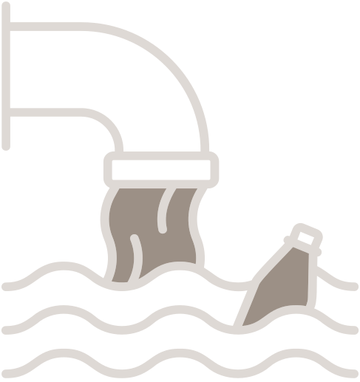
0
3
Session 2: Techniques for sustainable water management

Slide 16

Overview
  Sustainable water management ensures clean water availability while minimizing environmental impact.
  Techniques cater to different contexts, based on local conditions, resources, and specific needs of the population.
  Community engagement and integration of indigenous knowledge play critical roles in ensuring sustainable water management.

Slide 17
Safe Drinking Water Provision
Boiling: Heating water to a rolling boil to kill pathogens, making it safe for drinking.
    Simple, effective, and widely understood. Useful in areas without access to other technologies.
Filtration Systems: Using portable or community-based filtration systems to remove impurities and pathogens from water.
    Provides clean drinking water by removing physical contaminants and is suitable for long-term use.
Solar Water Disinfection (SODIS): Using sunlight to purify water in transparent plastic bottles.
    Cost-effective, environmentally friendly, and ideal for regions with high sunlight exposure.
Chlorination: Adding chlorine to water to kill bacteria, viruses, and protozoa.
    Low-cost, easy to implement at both small and large scales.
Reverse Osmosis (RO): High-tech filtration method using a semi-permeable membrane to remove contaminants from water.
    Highly effective in removing salts, chemicals, and pathogens, making it useful in coastal or industrial disaster areas.
Notes:
Initial 10 topics identified, based on:
review of currrent EHA elearning course
recent literature review
intenal discussions
17

Slide 18
Safe Drinking Water Provision
Biosand Filters: Slow sand filtration system that removes pathogens and suspended solids from water.
    Cost-effective, long-lasting, and can be locally manufactured for rural and emergency settings.
Desalination: The process of removing salt and impurities from seawater to make it potable.
    Crucial in coastal regions with limited freshwater, especially in emergencies.
Gravity-fed Water Systems: Systems that use gravity to transport water from higher elevations to communities.
    Requires minimal energy input and is low-maintenance, providing sustainable water access.
Water Purification Tablets: Tablets that kill pathogens in water.
    Portable and ideal for emergencies, providing immediate access to safe drinking water.
Constructed Wetlands: Engineered systems using wetland vegetation and soils to treat water.
    Environmentally friendly and creates wildlife habitats, while purifying greywater for reuse.
Notes:
18

Slide 19
Wastewater Treatment and Pollution Control
Septic Systems
    Underground systems that treat wastewater by separating solids and liquids.
    Prevents groundwater contamination and is effective in decentralized settings like rural areas.
Decentralized Wastewater Treatment Systems (DEWATS)
    Locally managed systems treating wastewater near its point of generation.
    Cost-effective, scalable, and reduces the need for centralized infrastructure.
Biosand Filters for Greywater
    Primarily used for drinking water purification but also effective for treating greywater.
    Provides a secondary treatment for greywater in low-resource settings, ensuring environmental safety.
Chemical Coagulation
    Adding chemicals to water to remove suspended solids and contaminants.
    Effective for treating highly polluted water and scalable for large volumes.
Anaerobic Digesters
    Systems that break down organic waste and wastewater without oxygen, producing biogas.
    Reduces environmental impact, generates renewable energy, and is useful in both urban and rural areas.
Notes:
19

Slide 20
Wastewater Treatment and Pollution Control
Bioremediation/Phytoremediation
    Use of microorganisms or plants to break down pollutants in wastewater.
    Environmentally friendly and promotes ecosystem restoration, useful in oil spill or industrial contamination areas.
UV Disinfection
    Using ultraviolet light to kill or inactivate microorganisms in wastewater.
    Effective without the need for chemicals, suitable for hospital wastewater treatment.
Aerated Lagoons
    Shallow ponds that treat wastewater using natural aeration and microbial activity.
    Cost-effective and suitable for treating large volumes of municipal or industrial wastewater.
Wetland Filtration
    Using wetlands to filter wastewater through vegetation and soil.
    Low-cost, sustainable, and creates habitats while improving water quality.
Notes:
20

Slide 21
Wastewater Treatment and Pollution Control
Mobile Wastewater Treatment Plants
    Portable units that treat wastewater on-site in emergencies.
    Quick to deploy and ensures immediate wastewater management in conflict zones or flood areas.
Greywater Recycling
    Reusing water from sinks, showers, and washing machines for non-potable purposes.
    Reduces demand on freshwater and minimizes wastewater generation, useful for irrigation and cleaning.
Advanced Oxidation Processes
    Chemical treatments that break down complex pollutants in wastewater.
    Highly effective for industrial pollutants and organic contaminants, particularly in disaster-affected areas.
Floating Treatment Wetlands
    Artificial floating platforms with vegetation to treat wastewater in ponds or lakes.
    Effective in areas with limited land, enhances water quality, and supports aquatic life.
Waterless Sanitation Systems
    Sanitation solutions that treat human waste without water.
    Ideal for water-scarce environments, reducing water contamination risks.
Notes:
21

Slide 22





Techniques for Conserving and Managing Water Resources
Rainwater Harvesting
Collecting and storing rainwater for use during dry periods.
Provides an independent water supply, particularly valuable in arid regions.
Techniques that enhance the natural replenishment of groundwater by directing rainwater into the soil.
Maintains groundwater levels, particularly useful in areas with depleted aquifers.
Groundwater Recharge
Water Reuse
Reusing treated wastewater for irrigation or industrial purposes.
Reduces reliance on freshwater sources, conserves water, and minimizes environmental impact.
Efficient irrigation technique that delivers water directly to plant roots, reducing waste.
Reduces water usage and promotes efficient agricultural practices, especially in camps or rural settings.
Drip Irrigation
Converting seawater into freshwater to provide long-term water supply in arid coastal regions.
Reliable freshwater source where natural sources are scarce, contributes to long-term sustainability.
Desalination
Notes:
22

Slide 23




Techniques for Conserving and Managing Water Resources
Water-saving Fixtures
Installing low-flow taps, showers, and toilets to reduce water usage.
Reduces overall water consumption in large-scale settings, particularly in refugee camps.
Leak Detection and Repair Programs
Identifying and fixing leaks in water distribution systems to prevent water loss.
Reduces water waste and ensures reliable water supply, particularly in urban refugee settings.
Storing surplus water in underground aquifers or reservoirs during wet periods for use during droughts.
Provides a reliable water supply during dry periods, stabilizing water availability.
Water Banking
Holistic management of water resources within a watershed, including land use and conservation.
Protects water sources, maintains ecosystem health, and ensures sustainable water use.
Watershed Management
Climate-resilient Water Infrastructure
Designing water infrastructure to withstand extreme weather events.
Ensures a reliable water supply during and after disasters, reducing repair costs and enhancing resilience.
Notes:
23

Slide 24



Techniques for Conserving and Managing Water Resources
Nature-based Solutions (NbS)
Using natural ecosystems like wetlands to manage water resources and control floods.
Enhances water quality, supports biodiversity, and offers sustainable management solutions.
Rotational Grazing
Managing livestock grazing to prevent overgrazing and soil degradation.
Protects water resources by maintaining soil health and supporting sustainable land use.
Integrated Water Resource Management (IWRM)
Coordinating the development and management of water, land, and related resources.
Ensures sustainable water use, balancing social, economic, and environmental needs.
Fog Harvesting
Collecting water from fog using nets or specialized structures.
Provides an alternative water source in arid or semi-arid regions, supporting water security.
Notes:
24

Slide 25
Sustainable water management ensures clean water availability while minimizing environmental impact.
Techniques cater to different contexts, based on local conditions, resources, and specific needs of the population.
Community engagement and integration of indigenous knowledge play critical roles in ensuring sustainable water management.

Slide 26
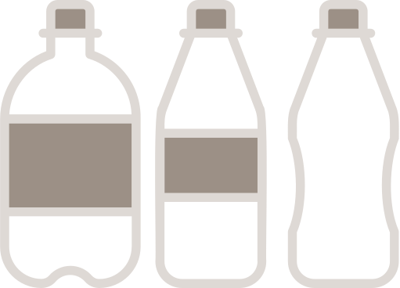
0
4
Session 4: Challenges and strategic solutions in water resource management

Slide 27

  Water resource management in humanitarian settings faces multiple challenges, including scarcity, contamination, infrastructure damage, and the impact of climate change.
  Climate change exacerbates these challenges by increasing the frequency and severity of extreme weather events such as floods, droughts, and storms, which further disrupt water availability and quality.
  These challenges can lead to health risks, environmental degradation, and increased vulnerability for affected populations.
  Effective solutions require innovative approaches, strong stakeholder coordination, and the integration of sustainable practices into humanitarian operations to improve water management outcomes.

Slide 28
Key challenges in water resource management
  Water scarcity: Limited availability of water resources, particularly in arid and drought-prone regions.
  Leads to competition for water, increased vulnerability, and challenges in maintaining hygiene.
  Water contamination: Pollution of water sources due to industrial activities, agricultural runoff, or poor sanitation.
  Increases the risk of waterborne diseases, affects ecosystem health, and reduces water usability.
  Infrastructure damage: Destruction of water supply systems and treatment facilities due to natural disasters or conflict.
  Disrupts water distribution, leading to shortages and increased health risks.
  Climate change impact: Altered precipitation patterns, increased frequency of extreme weather events, and rising temperatures.
  Exacerbates existing water management challenges and increases unpredictability in water availability.

Slide 29
Key challenges in water resource management
  Community resistance: Resistance from local communities to adopt new water management practices due to cultural beliefs or lack of awareness.
  Slows the implementation of effective water management strategies and exacerbates existing challenges.
  Poor coordination among stakeholders: Fragmented efforts and lack of collaboration among different humanitarian actors, local authorities, and communities.
  Leads to inefficiencies, duplication of efforts, and gaps in water service delivery.
  Financial constraints: Limited funding for water resource management projects, particularly in protracted crises.
  Affects the sustainability and scale of water management interventions.
  Inadequate data and monitoring: Lack of reliable data on water resources, usage patterns, and contamination levels.
  Hinders the planning and implementation of effective water management strategies.

Slide 30
Climate change exacerbations on water resource challenges in humanitarian action
  Altered precipitation patterns: Changes in rainfall distribution, intensity, and seasonality.
  Increased frequency and intensity of rainfall events, leading to more severe flooding and droughts.
  Increased frequency of extreme weather events: More frequent and intense storms, hurricanes, and cyclones.
  Greater likelihood of infrastructure damage, water source contamination, and disruptions to water supply.
  Rising sea levels: Rising sea levels due to melting polar ice and thermal expansion of seawater.
  Increased saltwater intrusion into coastal freshwater aquifers, further reducing available drinking water.
  Reduced groundwater recharge: Decreased infiltration of rainfall into the ground, leading to lower groundwater levels.
  Prolonged droughts and changes in land use further diminish groundwater recharge rates.

Slide 31
Climate change exacerbations on water resource challenges in humanitarian action
  Increased evaporation rates: Higher temperatures lead to greater evaporation from water bodies and soil.
  Increased evaporation due to rising temperatures further reduces surface water availability.
  Changes in water quality: Alteration in water temperature, pH, and contamination levels.
  Climate change-induced pollution, such as runoff from increased rainfall, degrades water quality.
  Shifts in water demand and use patterns: Changing agricultural practices, energy production, and domestic water use.
  Increased stress on water resources as communities adapt to climate change impacts, such as droughts.
  Increased flood risk and pollution: Flooding caused by extreme weather events leads to widespread pollution and water contamination.
  More frequent and severe flooding events heighten the risk of pollution and waterborne diseases.

Slide 32
Strategic solutions and best practices
Integrated water resource management (IWRM): A coordinated approach to managing water, land, and related resources to maximize social and environmental welfare.
    Promotes sustainable water use, ensures equitable distribution, and supports long-term water security.
Nature-based solutions (NBS): Utilizing natural processes and ecosystems to manage water resources and address environmental challenges.
    Enhances water quality, controls floods, and supports biodiversity while providing sustainable solutions.
Climate-resilient infrastructure: Designing and constructing water infrastructure that can withstand extreme weather events and climate change impacts.
    Ensures reliable water supply during and after disasters, reduces repair costs, and enhances community resilience.
Community engagement and education: Actively involving local communities in water management decisions and educating them on sustainable practices.
    Ensures community buy-in, enhances the sustainability of interventions, and leverages local knowledge.

Slide 33
Strategic solutions and best practices
Advanced water treatment technologies: Implementing high-tech solutions like reverse osmosis, UV disinfection, and advanced oxidation processes to ensure water quality.
    Provides effective treatment of contaminated water sources, particularly in areas with industrial pollution.
Decentralized water management systems: Establishing small-scale, locally managed water systems that operate independently of centralized infrastructure.
    Reduces reliance on large-scale infrastructure, improves resilience, and ensures quicker response times in emergencies.
Financial mobilization and resource allocation: Securing funding and efficiently allocating resources for water management projects in humanitarian contexts.
    Ensures the sustainability and scalability of water management interventions.
Data-driven decision making: Using real-time data and advanced monitoring technologies to inform water management strategies.
    Enhances the accuracy of planning, improves resource allocation, and ensures timely interventions.

Slide 34

0
5
Session 4: Case studies and practical exercises

Slide 35

Source: Humanitarian Action
Context: Prolonged droughts and conflict.
Challenges: Severe water depletion affecting drinking water, hygiene, and sanitation.
Response: WASH Cluster 2024 implemented small-scale, climate-resilient solutions such as household water treatments, chlorination, reverse osmosis plants, and hand-pump repairs.
Lessons: Community involvement is crucial; integrated WASH services improve outcomes; climate-resilient water solutions are key.
Water Management in Afghanistan
Notes:
35

Slide 36
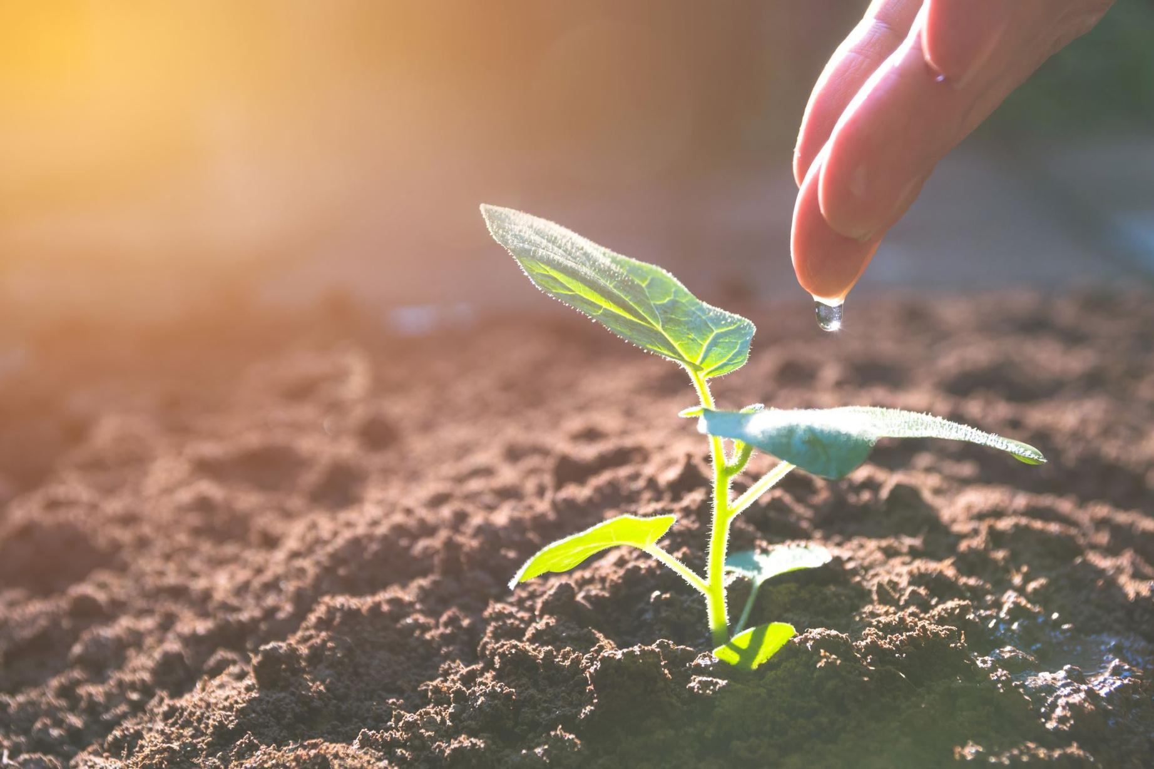
Water and Sanitation in Post-Earthquake Haiti
Context: Recovery efforts post-2010 earthquake.
Challenges: Damaged water and sanitation infrastructure, waste management issues.
Response: Various NGOs and DINEPA (Haitian Water and Sanitation National Directorate) coordinated efforts on water trucking, bladder tanks, chlorination, composting toilets, and waste recycling.
Lessons: Coordination among stakeholders is essential; disaster preparedness is crucial to effective water and sanitation management.

Slide 37
Rainmaker Enterprise in South Sudan
Context: Drought and climate-induced water scarcity exacerbated by conflict.
Challenges: Competition over limited water resources affecting agriculture and increasing conflict.
Response: Rainmaker Enterprise implemented solar-powered drip irrigation systems combined with traditional knowledge to provide sustainable water supply and reduce conflict.
Lessons: Community-driven, innovative water management solutions build long-term resilience and sustainability.

Slide 38
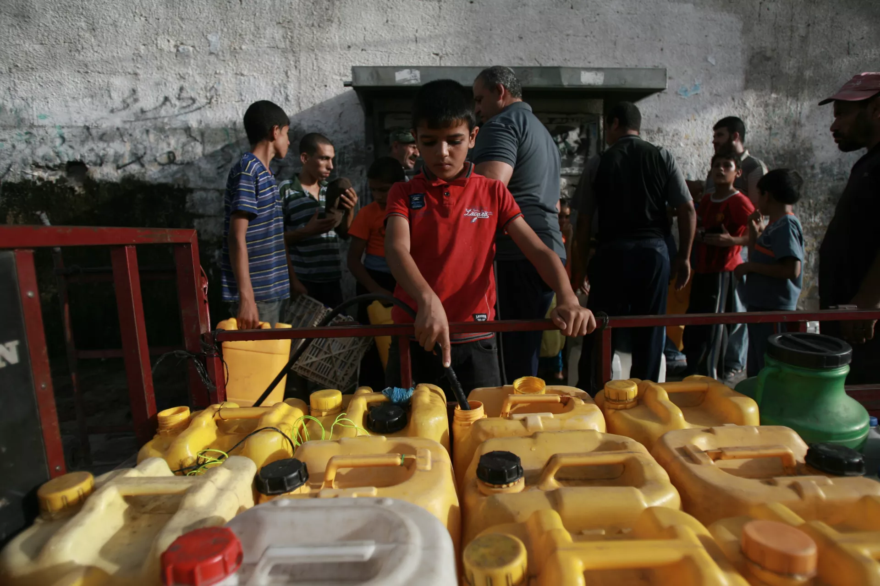
Water Desalination in Gaza
Context: Chronic water scarcity worsened by conflict and blockades.
Challenges: High salinity and contamination in over 90% of the region’s water sources.
Response: UNICEF installed small-scale desalination plants to provide clean water through public taps and tanks.
Lessons: Decentralized, small-scale desalination systems can provide immediate relief; reliable power access is key to their success.
Source: UNICEF
Notes:
38

Slide 39
Key Takeaways
Effective water management is critical for health, sanitation, and environmental stability during crises, ensuring safe drinking water and ecosystem protection.
Surface water, groundwater, rainwater harvesting, and desalination each have unique benefits and challenges in emergencies, requiring tailored approaches.
Methods such as safe drinking water provision, wastewater treatment, and conservation practices protect public health and strengthen water systems' resilience.
Engaging local communities and incorporating indigenous knowledge improves sustainability and effectiveness in water resource management.
Key challenges include water scarcity, contamination, infrastructure damage, and climate change impacts, all posing risks to water availability and quality.
Climate change intensifies water management challenges through extreme weather and altered rainfall, making climate-resilient infrastructure and adaptation crucial.
Solutions like IWRM, advanced technologies, and nature-based approaches, combined with stakeholder coordination, can address water management challenges.
Real-world examples offer insights into successful water management, highlighting community-driven solutions, technology integration, and adaptable systems.
Water management should be aligned with broader interventions like health, WASH, and environmental protection for long-term sustainability.

Slide 40
Thank you
Any Questions?

