Slide 1



ENVIRONMENT IN HUMANITARIAN ACTION (EHA) TRAINING
Module 5:
Climate Change Adaptation and Disaster Risk Reduction
Name of Facilitator:
Venue:
Date:

Slide 2

Module Outline
0
1
Introduction to climate change adaptation and disaster risk reduction
0
4
Environment-focused adaptation and DRR measures
Nexus between climate change, disaster risk, environment, and humanitarian action
0
2
0
5
Case studies and best practices
Strategies for integrating climate change adaptation and DRR into humanitarian programs
0
3
Notes:
2

Slide 3

0
1
Module Learning Outcomes

Slide 4
By the end of this module, you should be able to:
Understand the relationship between climate change, DRR, environment, and humanitarian action.
Integrate climate change adaptation and DRR strategies into humanitarian programs.
Develop and implement adaptation and DRR measures for various disaster types at different levels.
Utilize climate risk assessments and environmental screening tools in humanitarian contexts.
Incorporate nature-based solutions, anticipatory action, and forecast-based financing into their strategies.
Analyze case studies to identify best practices for integrating climate change adaptation and DRR.
Notes:
4

Slide 5

0
2
Session 1: Introduction to climate change adaptation and disaster risk reduction

Slide 6

Introduction
Climate change impact: More frequent extreme weather events and prolonged disasters.
Climate Shocks: Sudden events (e.g., storms, floods).
Climate Stresses: Long-term events (e.g., droughts, sea-level rise).
Need for adaptation & DRR: Minimizing impacts and preparing vulnerable populations with sustainable practices.

Slide 7




Key Concepts
Climate change adaptation: Adjustments to reduce vulnerability to climate hazards and support resilience.
Example: Implementing flood-resilient infrastructure.
Disaster risk reduction (DRR): Strategies to prevent, reduce, or manage disaster risks.
Example: Community-based disaster preparedness plans.
Multi-hazard approach: Managing multiple risks (e.g., floods, droughts, and conflict) to enhance preparedness.
Rapid vs. Slow-onset disasters:
Rapid: Sudden, severe events like floods.
Slow: Gradual threats like drought or desertification.
Notes:
7

Slide 8



Practical Tools and Strategies
Anticipatory Action: Taking proactive measures before a disaster strikes, based on forecasts (e.g., pre-positioning relief supplies).
Forecast-based Financing (FbF): Triggering early actions through pre-arranged funds, minimizing damage before disasters.
Nature-Based Solutions (NbS): Using ecosystems to reduce disaster risks (e.g., restoring mangroves to protect coastal communities).
Notes:
8

Slide 9

Session 2: Nexus between climate change, disaster risk, environment, and humanitarian action
0
3

Slide 10



Source: IPCC
Overview
Climate Change: A major driver of increased disaster risk.
Integration of Environment & Humanitarian Action: Necessary for developing sustainable and effective responses.
Need for Adaptation and DRR: Helps to mitigate impacts and build resilience in humanitarian settings.
Notes:
10

Slide 11


Climate Change - Positive and Negative Interactions
Positive:
Negative:
Promotes resilience and adaptation strategies.
Encourages innovation in sustainable practices and international cooperation.
Example: Implementing early warning systems and renewable energy solutions in disaster-affected regions.
Increases disaster severity, overwhelming humanitarian capacities.
Displaces populations, creating new challenges for resources and recovery.
Example: Hurricanes causing massive displacements and infrastructure damage.
Notes:
11

Slide 12
DRR- Positive and Negative Interactions
Positive:
Negative:
Reduces disaster impacts, builds community resilience, and integrates local knowledge in preparedness.
Example: Developing community disaster preparedness plans and conducting regular drills.
Fragmented responses and conflicts over resource allocation can undermine DRR efforts if not integrated.
Example: Conflicting resource allocation during simultaneous disaster relief and long-term DRR efforts.
Notes:
12

Slide 13
CCA- Positive and Negative Interactions
Positive:
Negative:
Increases community resilience, promotes sustainable practices, and integrates traditional knowledge with scientific approaches.
Example: Climate-resilient agricultural practices and infrastructure designed to withstand extreme weather.
Can be resource-intensive, leading to maladaptation or conflicts over land and resources.
Example: High costs of implementing adaptation projects and land-use conflicts over reforestation.
Notes:
13

Slide 14
Environment in Humanitarian Action - Positive and Negative Interactions
Positive:
Negative:
Ensures sustainable responses, reducing long-term environmental impacts and promoting ecosystem-based approaches.
Example: Using sustainable materials and conducting environmental assessments before projects.
Environmental degradation exacerbates disaster risks and creates a feedback loop of worsening conditions.
Example: Deforestation for firewood leading to increased vulnerability to climate-related disasters.
Notes:
14

Slide 15
Humanitarian Action - Positive and Negative Interactions
Positive:
Negative:
Integrating DRR and climate adaptation into humanitarian action ensures a holistic approach, improving long-term resilience.
Example: Providing training and resources for local communities to enhance disaster preparedness.
Lack of integration can lead to short-term fixes without addressing underlying vulnerabilities.
Example: Repeated short-term relief efforts leading to recurring vulnerabilities and donor fatigue.
Notes:
15

Slide 16
Conflict-Sensitive Approach - Positive and Negative Interactions
Positive:
Negative:
Ensures that DRR or adaptation actions promote peaceful coexistence, preventing conflicts from escalating.
Example: Integrating conflict sensitivity into disaster preparedness plans and promoting community dialogue.
Poorly managed responses can exacerbate tensions and lead to conflict over resources.
Example: Displacement and tension between host communities and displaced populations due to resource allocation.
Notes:
16

Slide 17

0
4
Session 3: Strategies for integrating climate change adaptation and DRR into humanitarian programs

Slide 18


Introduction
Risk and vulnerability understanding: The basis for developing climate adaptation and DRR strategies.
Adaptation as proactive action: Focus on community resilience by mitigating hazards before they occur.
Nature-based Solutions: Provide sustainable methods for enhancing long-term resilience.
Anticipatory action: Ensures timely adaptation and DRR efforts by reducing the need for reactive responses.

Slide 19
Strategies for Integrating Climate Change Adaptation and DRR into Humanitarian Programs
Climate Risk Assessment
    Identifying and evaluating risks posed by climate change to communities and infrastructure.
    Importance: Provides the foundation for creating targeted adaptation and disaster risk reduction strategies.
    Examples:
      Conducting community-based vulnerability assessments.
      Utilizing climate models to predict future risks.
      Assessing infrastructure vulnerability to climate impacts.
Adaptation Planning
    Developing proactive measures to address the impacts of climate change, focusing on prevention and early action.
    Importance: Prepares communities to cope with climate-related hazards, reducing reactive measures.
    Examples:
      Climate adaptation plans for agriculture and water management in drought-prone areas.
      Constructing flood defenses in flood-prone regions.
      Training communities on sustainable practices and raising awareness about climate change.
Notes:
19

Slide 20
Strategies for Integrating Climate Change Adaptation and DRR into Humanitarian Programs
Integrating DRR into Humanitarian Programs
    Incorporating disaster risk reduction measures into humanitarian programs to minimize disaster impact.
    Importance: Enhances community resilience and reduces disaster risks.
    Examples:
      Including disaster preparedness activities in aid programs.
      Implementing early warning systems in high-risk communities.
Nature-Based Solutions
    Using natural processes like reforestation, mangrove restoration, and green spaces to increase resilience.
    Importance: Provides sustainable, cost-effective ways to mitigate climate impacts and protect ecosystems.
    Examples:
      Restoring mangroves to protect coastal areas from storm surges.
      Reforesting degraded lands to prevent landslides and improve water retention.
      Creating urban green spaces to reduce heat island effects.
      Integrating DRR into school curricula and community training programs.
Notes:
20

Slide 21
Strategies for Integrating Climate Change Adaptation and DRR into Humanitarian Programs
Anticipatory Action
    Implementing proactive measures to mitigate disaster risks before they occur, based on forecasts.
    Importance: Reduces the impact of disasters by enabling timely actions based on early warnings.
    Examples:
      Pre-positioning relief supplies in anticipation of floods.
      Using climate forecasts to trigger early action plans.
      Implementing cash transfer programs before predicted droughts.
Forecast-Based Financing
    Financial mechanisms that release funds based on climate forecasts to support anticipatory action.
    Importance: Enables timely and effective responses to climate-related events, reducing losses and damage.
    Examples:
      Triggering early action for impending droughts using forecast-based financing.
      Linking social protection systems to climate forecasts for timely support to vulnerable populations.
Notes:
21

Slide 22
Strategies for Integrating Climate Change Adaptation and DRR into Humanitarian Programs
Innovative Financing Models
    Financial instruments like micro-insurance and risk-transfer to support community resilience.
    Importance: Provides sustainable funding to ensure rapid recovery after disasters and enhance resilience.
    Examples:
      Implementing micro-insurance schemes for farmers in drought-prone areas.
      Utilizing risk-transfer instruments to fund recovery efforts after major disasters.
Risk-Informed Programming
    Incorporating risk assessments to align humanitarian programs with areas of high vulnerability.
    Importance: Enhances program effectiveness by targeting the most critical needs.
    Examples:
      Conducting risk assessments before program implementation.
      Overlaying risk analysis with development programs to identify strategic gaps.
Notes:
22

Slide 23

0
5
Session 4: Environment-focused adaptation and DRR measures

Slide 24

Introduction
  Tailored adaptation and DRR strategies mitigate environmental impacts of disasters in humanitarian settings.
  A flexible framework allows for developing targeted, effective responses for any environmental challenge.
  Understanding specific measures for different environmental impacts enhances preparedness and response under changing climate conditions.

Slide 25
Environment-focused adaptation and DRR measures
Water Scarcity
Challenge: Prolonged low rainfall, affecting agriculture, water supply, and ecosystems.
Measures: Water conservation, drought-resistant crops, rainwater harvesting, efficient irrigation.
Examples: Community water storage systems, promoting drought-resistant crops.
Link to Climate Change: Altered rainfall patterns and deforestation reduce water retention, worsening droughts.
Flooding
Challenge: Overflow of water onto dry land due to rainfall, storms, or dam breakage.
Measures: Building flood barriers, creating early warning systems, sustainable drainage, restoring wetlands.
Examples: Installing flood barriers, restoring wetlands to absorb floodwaters.
Link to Climate Change: Increased rainfall intensity from climate change and deforestation reduces land’s ability to absorb excess water, worsening floods.
Wildfire
Challenge: Uncontrolled fires fueled by dry conditions and human activities.
Measures: Controlled burns, firebreaks, fire-resistant building materials, early warning systems.
Examples: Conducting controlled burns, establishing firebreaks.
Link to Climate Change: Drier conditions and heatwaves increase wildfire risk, while deforestation removes natural barriers that slow fire spread.

Slide 26
Environment-focused adaptation and DRR measures
Extreme Weather Events
Challenge: Intense storms, heatwaves, cold waves impacting infrastructure and ecosystems.
Measures: Strengthening infrastructure, urban greening, early warning systems.
Examples: Building storm-resistant shelters, urban green spaces to reduce heat island effects.
Link to Climate Change: Increased severity of storms and heatwaves due to climate change, exacerbated by loss of green spaces.
Coastal Erosion
Challenge: Removal of beach or dune sediments by wave action, accelerated by human activities.
Measures: Coastal defenses, mangrove restoration, sustainable coastal zone management.
Examples: Restoring mangroves, implementing coastal defenses.
Link to Climate Change: Rising sea levels and stronger storms accelerate coastal erosion, worsened by mangrove destruction.
Landslides
Challenge: Movement of debris down slopes, often triggered by rain or human activities.
Measures: Slope stabilization, reforestation, drainage improvements, retaining walls.
Examples: Reforesting slopes, constructing retaining walls.
Link to Climate Change: Heavier rains increase landslide risk, while deforestation reduces slope stability.

Slide 27
Environment-focused adaptation and DRR measures
Conflicts
Challenge: Conflicts and wars causing displacement, habitat destruction, and resource depletion.
Measures: Sustainable resource management, safe zones, conflict-sensitive environmental practices.
Examples: Managing natural resources sustainably in refugee camps, establishing safe zones.
Link to Climate Change: Climate-induced resource scarcity can fuel conflicts, exacerbated by environmental degradation.
Earthquakes
Challenge: Sudden seismic activity damaging infrastructure and triggering landslides.
Measures: Earthquake-resistant buildings, retrofitting, preparedness training.
Examples: Implementing earthquake-resistant building codes, retrofitting structures.
Link to Environment: While not directly linked to climate change, deforestation increases vulnerability to landslides after earthquakes.
Health-Related Disasters
Challenge: Outbreaks of diseases exacerbated by environmental changes and poor healthcare infrastructure.
Measures: Strengthening healthcare infrastructure, early warning systems, public health awareness.
Examples: Community education programs, early warning systems for disease outbreaks.
Link to Climate Change: Changing weather patterns and deforestation increase the spread of vector-borne diseases and reduce clean water availability.

Slide 28

0
6
Session 5: Case studies and best practices

Slide 29
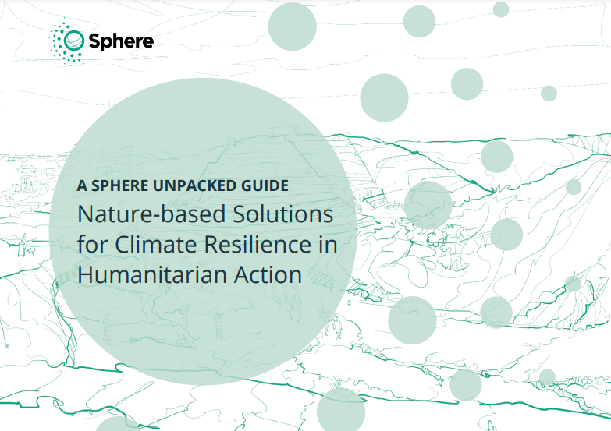
Sphere Unpacked Guide on Nature-Based Solutions
  Relevance: Provides a framework for environmentally sustainable practices in disaster risk reduction and climate change adaptation.
  Application: Implement green infrastructure in refugee camps (community gardens, green roofs); Restore wetlands in flood-prone areas; Promote mangrove restoration in coastal zones; Develop water conservation systems in drought-affected regions.
  Implementing Entities: Humanitarian practitioners using NbS for resilience building and sustainable resource management in humanitarian settings.
Source: Sphere Association
Notes:
29

Slide 30
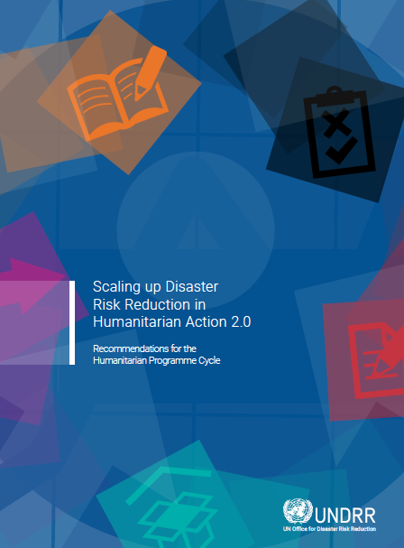
UNDRR Guidelines for Scaling Up DRR in Humanitarian Action
  Relevance: Offers structured guidance for integrating disaster risk reduction into humanitarian programs, emphasizing risk-informed approaches.
  Application: Conduct risk assessments, incorporate DRR strategies into humanitarian response, collaborate with local authorities, promote sustainable resource management.
  Implementing Entities: Humanitarian actors collaborating with local/national authorities and communities for risk-informed, sustainable humanitarian action.
Source: UNDRR
Notes:
30

Slide 31
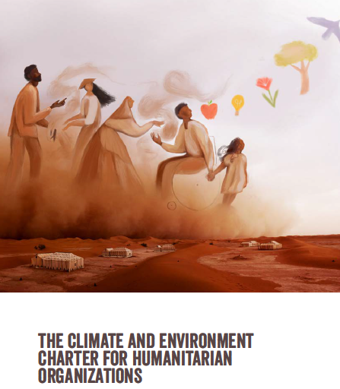
Climate and Environment Charter
  Relevance: Provides a framework for addressing climate and environmental crises through climate change adaptation, DRR, and anticipatory action.
  Application: Implement resilience-building and risk reduction measures, reduce emissions, support local adaptation efforts, collaborate for climate action.
  Implementing Entities: Humanitarian organizations adopting the charter principles in all phases of humanitarian programs.

Slide 32
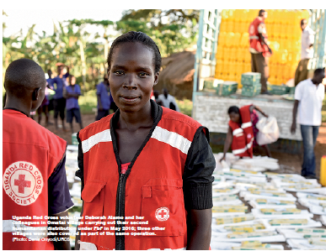
Forecast-Based Financing (FbF) in Togo and Uganda
  Relevance: Demonstrates how forecast-based financing (FbF) can mitigate disaster impacts by pre-empting flood risks.
  Application: Prepositioning relief stocks, mobilizing communities for flood preparedness, implementing early actions triggered by forecasts.
  Implementing Entities: Uganda Red Cross and Togo Red Cross leading community mobilization and early action based on forecast triggers.
Source: IFRC
Notes:
32

Slide 33
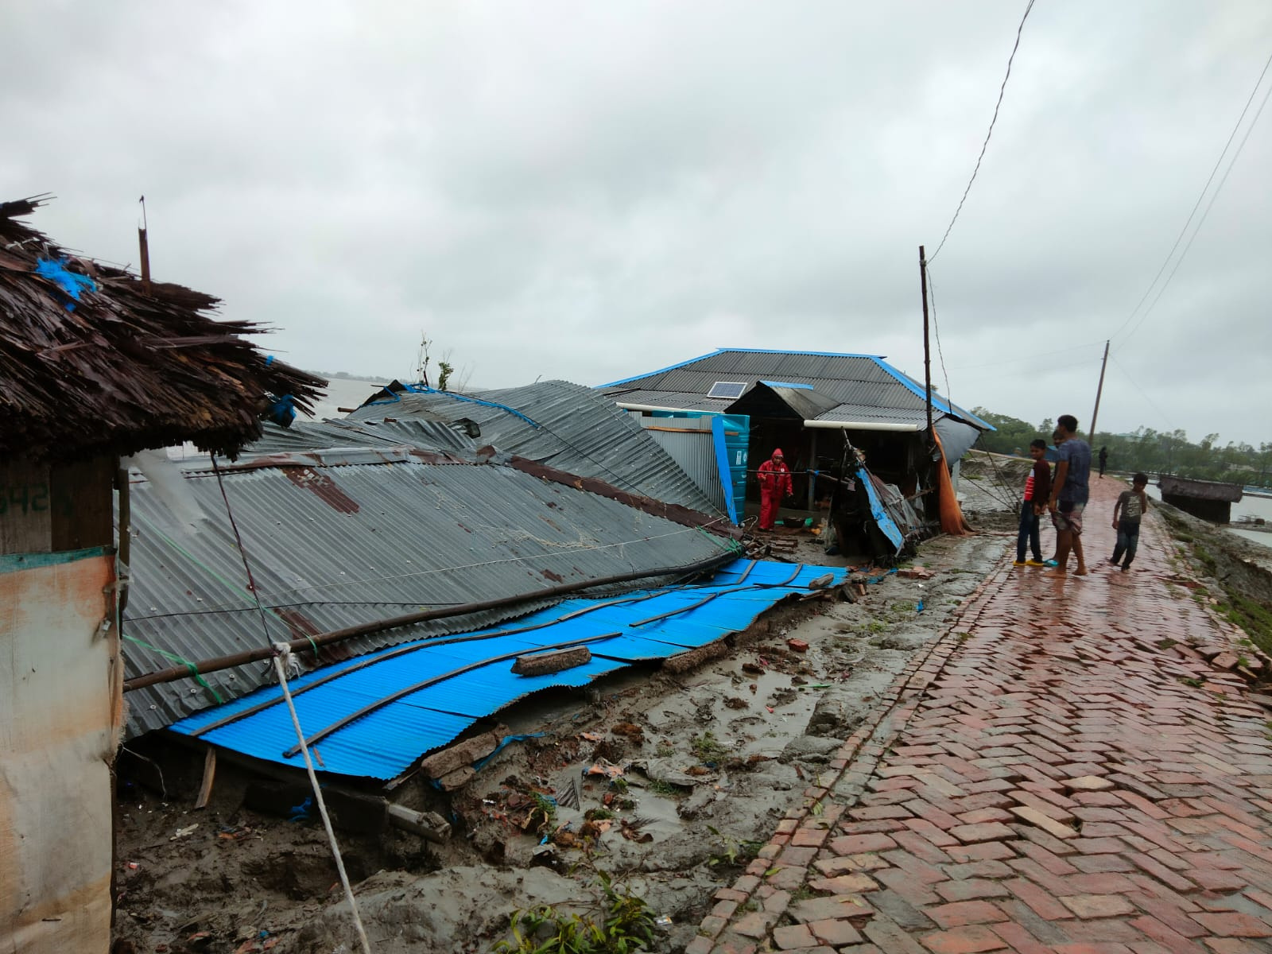
Anticipatory Action for Cyclone Remal in Bangladesh
  Relevance: Highlights the effectiveness of anticipatory action and rapid financing mechanisms in mitigating the impacts of cyclones.
  Application: Funding was used for evacuations, provision of supplies, and post-landfall response. Early activation of financing mechanisms enabled timely assistance.
  Implementing Entities: Start Bangladesh and FOREWARN Bangladesh activated Start Fund and Start Ready for proactive humanitarian response.
Source: Start Network
Notes:
33

Slide 34
Key Takeaways
Climate change increases disaster risk, disproportionately affecting vulnerable communities; integrating climate adaptation (CCA) and disaster risk reduction (DRR) is essential for building resilience.
Integrating CCA and DRR into humanitarian programs reduces vulnerabilities and enhances preparedness through early warning systems and proactive planning.
Holistic approaches are necessary to address the nexus between climate change, disaster risk, environmental degradation, and humanitarian action.
Tailored adaptation and DRR strategies, including nature-based solutions (NbS), enhance effectiveness in addressing environmental challenges like flooding, drought, and coastal erosion.
Innovative approaches like anticipatory action and forecast-based financing (FbF) ensure timely, effective responses to climate-related risks.
Case studies demonstrate the importance of early action, collaboration, and context-specific solutions for integrating CCA and DRR.
Risk assessment tools improve decision-making by identifying vulnerabilities and tailoring strategies to local conditions.
Balancing immediate relief with long-term sustainability ensures that humanitarian responses do not undermine future resilience.
Engaging local communities and incorporating indigenous knowledge enhances the sustainability and cultural relevance of adaptation and DRR interventions.

Slide 35
Thank you
Any Questions?

