Slide 1



ENVIRONMENT IN HUMANITARIAN ACTION (EHA) TRAINING
Module 8:
Environmental Mainstreaming in Humanitarian Programs
Name of Facilitator:
Venue:
Date:

Slide 2
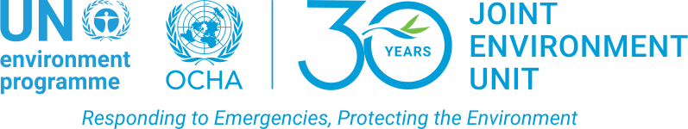
Module Outline
0
Introduction to environmental mainstreaming
1
0
Financing environmental mainstreaming in humanitarian action
4
Step-by-step guide for mainstreaming environmental considerations
0
2
0
5
Case studies and best practices
Cluster-specific environmental impacts and mitigation strategies
0
3
Notes:
2

Slide 3

0
1
Module Learning Outcomes

Slide 4
By the end of this module, you should be able to:
Understand the significance of environmental mainstreaming in reducing the environmental and carbon footprint of humanitarian programs.
Identify key entry points, enablers and financing opportunities for integrating environmental considerations into humanitarian actions.
Develop and implement environmental policies and guidelines in line with global and regional frameworks.
Analyze environmental impacts across different humanitarian clusters and propose appropriate mitigation strategies.
Apply a step-by-step process to mainstream environmental considerations into humanitarian programs, ensuring compliance with relevant policies and best practices.
Learn from real-world case studies that illustrate successful environmental mainstreaming in various humanitarian contexts.
Notes:
4

Slide 5

0
2
Session 1: Introduction to environmental mainstreaming

Slide 6





Introduction
Significance: Integrating environmental considerations into humanitarian programs enhances sustainability, resilience, and reduces negative impacts.
Why it matters: It aligns humanitarian actions with global environmental goals, ensuring sustainable operations and promoting long-term recovery.
Entry Points: Environmental mainstreaming can be incorporated at multiple stages—needs assessments, project design, implementation, and monitoring.
Enablers: Leadership commitment, capacity building, funding, stakeholder engagement, and policy support are key to successful environmental mainstreaming.
Reducing Footprint: Prioritizing energy efficiency, resource conservation, and eco-friendly practices minimizes the environmental and carbon footprint.

Slide 7
Importance of Environmental Mainstreaming
Improves sustainability: Ensures that humanitarian interventions are sustainable over the long term.
Example: Using renewable energy (solar power) in field offices and camps instead of diesel generators to minimize environmental degradation and carbon emissions.
Enhances community resilience: Builds the capacity of communities to withstand and recover from environmental shocks.
Example: Implementing reforestation projects in flood-prone areas to strengthen natural flood barriers and enhance community safety.
Reduces environmental impact: Minimizes the negative effects of humanitarian actions on the environment.
Example: Using eco-friendly construction materials for shelters to avoid deforestation and land degradation in refugee camps.
Promotes resource efficiency: Optimizes the use of natural resources, reducing waste and operational costs.
Example: Implementing water-saving technologies in WASH projects in drought-affected regions to reduce pressure on local water sources.
Ensures compliance with regulations: Meets local and international environmental laws and standards.
Example: Following environmental impact assessment (EIA) guidelines when constructing new shelters in environmentally sensitive areas.
Supports better decision-making: Provides a basis for informed decision-making that incorporates environmental considerations.
Example: Using GIS data to avoid placing refugee camps in flood-prone areas, reducing potential damage.

Slide 8
Importance of Environmental Mainstreaming
Enhances operational effectiveness: Leads to more effective and efficient humanitarian operations by integrating environmental best practices.
Example: Streamlining waste management in camps to reduce pollution and improve health outcomes for displaced populations.
Fosters stakeholder trust and collaboration: Engages stakeholders and builds trust through transparent and responsible environmental practices.
Example: Involving local communities in environmental monitoring and resource management programs in conflict-affected areas.
Contributes to global environmental goals: Aligns humanitarian actions with broader environmental and climate goals.
Example: Reducing GHG emissions in humanitarian operations through renewable energy, contributing to the Paris Agreement’s climate goals.
Improves health and well-being: Reduces health risks associated with environmental degradation and pollution.
Example: Ensuring proper waste disposal in camps to prevent water contamination and outbreaks of waterborne diseases.

Slide 9
Entry Points for Environmental Mainstreaming
  Needs assessment: Incorporate environmental criteria to identify potential impacts and opportunities for mitigation.
    Example: Including environmental questions in assessments before setting up temporary shelters in forested regions.
  Project design: Integrate environmental considerations into the design phase to ensure sustainability.
    Example: Designing solar-powered street lighting systems in camps to reduce energy consumption.
  Implementation: Apply environmentally friendly practices during project execution.
    Example: Using eco-friendly materials for shelter construction, such as bamboo and recycled plastics.

Slide 10
Entry Points for Environmental Mainstreaming
  Monitoring and evaluation: Track environmental performance and adapt strategies as needed.
    Example: Regularly reviewing the use of fuel generators and transitioning to solar energy in disaster-affected areas.
  Policy development: Integrate environmental considerations into the design of humanitarian policies.
    Example: Developing policies that prioritize the use of sustainable resources in all humanitarian operations.
  Contingency planning: Incorporate environmental risks and mitigation strategies into contingency plans.
    Example: Developing flood risk mitigation strategies for camps located in low-lying areas prone to heavy rainfall.

Slide 11
Entry Points for Environmental Mainstreaming
  Proactive environmental measures: Develop and implement proactive measures to address potential environmental impacts.
      Example: Establishing buffer zones around camp areas to protect against land degradation and deforestation.
  Training and capacity building: Provide training on environmental issues to build capacity within humanitarian organizations.
      Example: Conducting workshops on environmental best practices for humanitarian workers using NEAT+.
  Grant applications: Include environmental considerations as part of grant application requirements.
      Example: Applying for funding from DG ECHO, which requires environmental criteria to be included in all project proposals.

Slide 12

Enablers for Effective Environmental Mainstreaming in Humanitarian Contexts
  Leadership commitment: Strong leadership support is essential for prioritizing environmental considerations.
  Example: Senior management advocating for green technologies in humanitarian logistics, such as electric vehicles for aid delivery.
  Stakeholder engagement: Involving local communities, governments, and other stakeholders ensures relevance and sustainability.
  Example: Collaborating with local governments to ensure environmental protection during the construction of new settlements for displaced people.
  Capacity building: Training and development are necessary to build skills and knowledge.
  Example: Providing humanitarian staff with NEAT+ training for assessing and mitigating environmental impacts.

Slide 13

Enablers for Effective Environmental Mainstreaming in Humanitarian Contexts
  Access to environmental expertise: Collaborating with environmental experts provides valuable insights.
  Example: Partnering with environmental organizations to assess the impact of deforestation and implement reforestation projects in camps.
  Funding and resources: Securing financial resources is essential to implement environmental initiatives.
  Example: Applying for grants focused on renewable energy installations in camps, such as installing solar panels.
  Policy and regulatory support: Establishing supportive policies ensures environmental considerations in humanitarian operations.
  Example: Adhering to international environmental standards, such as the Sendai Framework for Disaster Risk Reduction, during humanitarian response planning.

Slide 14

Enablers for Effective Environmental Mainstreaming in Humanitarian Contexts
  Awareness and education: Raising awareness is key to ensuring that environmental sustainability is prioritized.
  Example: Conducting environmental awareness campaigns for displaced communities to reduce deforestation for firewood.
  Monitoring and evaluation: Establishing systems to track environmental performance and progress.
  Example: Setting up environmental monitoring frameworks to track deforestation levels in camps and mitigate further damage.
  Technology and innovation: Leveraging new technologies to enhance sustainability.
  Example: Implementing GIS mapping to identify the most sustainable locations for camp construction.
  Cross-sectoral collaboration: Working across sectors ensures comprehensive environmental action.
  Example: Collaborating with the health sector to manage waste sustainably and reduce health risks in camps.

Slide 15
Global and Regional Frameworks and Policies
Paris Agreement: International treaty focused on climate change mitigation through GHG reductions.
Sendai Framework for Disaster Risk Reduction (SFDRR): Emphasizes disaster risk reduction, including environmental considerations.
Sustainable Development Goals (SDGs): Global framework with environmental goals, such as SDG 13 (Climate Action).
Example: Reducing carbon emissions by transitioning to renewable energy sources in humanitarian operations, contributing to global climate goals.
Example: Integrating climate resilience measures into WASH programs in refugee camps to align with SDG 6 (Clean Water and Sanitation).
Example: Incorporating disaster risk reduction measures, like flood defenses, in camp construction.

Slide 16
Global and Regional Frameworks and Policies
Basel Convention: Controls the transboundary movement and disposal of hazardous wastes.
European Union Environmental Policy: Regional framework guiding environmental protection within the EU.
International Humanitarian Law (IHL) and Environmental Protection: Provides guidelines for environmental protection during armed conflicts.
UNFCCC and Kyoto Protocol: Global efforts to address climate change, particularly in disaster-prone regions.
Example: Ensuring the safe disposal of hazardous medical waste in refugee camps to comply with the Basel Convention.
Example: Adhering to EU environmental regulations when conducting humanitarian projects funded by the EU.
Example: Avoiding the destruction of natural resources during humanitarian operations in conflict zones, in line with IHL principles.
Example: Implementing climate-adaptive shelter designs in disaster-affected areas to reduce GHG emissions and build resilience.

Slide 17

0
3
Session 2: Step-by-step guide for mainstreaming environmental considerations

Slide 18
Introduction
A systematic approach is essential for effective environmental mainstreaming in humanitarian programs.
Developing and implementing environmental policies ensures that environmental considerations are consistently integrated into humanitarian actions.

Slide 19

Step-by-step Guide for Mainstreaming Environmental Considerations
Needs assessment
  Detailed Process:
  Identify key environmental aspects relevant to the humanitarian project.
  Use assessment tools like NEAT+ to evaluate potential environmental impacts in crisis-affected areas.
  Engage local communities and stakeholders to identify environmental risks and opportunities.
  Importance: Provides a comprehensive understanding of potential environmental impacts and informs targeted mitigation strategies.
  Example: Conducting a rapid environmental assessment in refugee camps using the NEAT+ tool, ensuring local environmental challenges are considered in project planning.
Notes:
19

Slide 20
Step-by-step Guide for Mainstreaming Environmental Considerations
Policy development
  Detailed Process:
    Review existing humanitarian policies for gaps in environmental considerations.
    Develop or update policies to include specific environmental guidelines for humanitarian operations.
    Ensure policies align with international humanitarian and environmental guidelines.
  Importance: Establishes a clear framework for environmental action, ensuring consistency across operations.
  Example: Developing new sustainability policies for disaster response that include criteria for eco-friendly materials and resource use, aligned with Sphere and UNEP/OCHA guidelines.
Notes:
20

Slide 21

Step-by-step Guide for Mainstreaming Environmental Considerations
Project design
  Detailed Process:
    Incorporate environmental criteria into project planning and design.
    Ensure designs focus on minimizing resource use and environmental impact.
    Include broader sustainability considerations like waste reduction and energy efficiency.
  Importance: Embeds sustainability from the start, leading to more effective and resilient outcomes.
  Example: Designing energy-efficient, solar-powered shelters using locally sourced materials to reduce the environmental impact of temporary housing in disaster zones.
Notes:
21

Slide 22

Step-by-step Guide for Mainstreaming Environmental Considerations
Implementation
  Detailed Process:
    Apply environmentally friendly practices during project execution.
    Engage staff and partners in using green practices.
    Monitor environmental impacts throughout the implementation phase.
  Importance: Ensures the practical application of environmental policies, reducing negative impacts and enhancing sustainability.
  Example: Implementing renewable energy systems, like solar panels in field hospitals, and launching waste reduction initiatives in refugee camps.
Notes:
22

Slide 23

Step-by-step Guide for Mainstreaming Environmental Considerations
Training and capacity building
  Detailed Process:
    Develop and deliver tailored training programs on environmental mainstreaming.
    Use existing programs like NEAT+ for organizations with limited resources.
    Foster continuous learning by providing toolkits and training for humanitarian staff.
  Importance: Builds the capacity to effectively integrate environmental practices in operations.
  Example: Conducting workshops on environmental impact assessment and training staff on implementing best practices during emergency response.
Notes:
23

Slide 24

Step-by-step Guide for Mainstreaming Environmental Considerations
Monitoring and evaluation
  Detailed Process:
    Establish monitoring frameworks to track environmental performance.
    Conduct regular evaluations to assess the effectiveness of environmental policies and practices.
    Use results to update policies and practices as needed.
  Importance: Ensures continuous improvement in environmental performance, adapting to changing conditions.
  Example: Reviewing the environmental impact of waste disposal practices in refugee camps and adjusting operations based on findings.
Notes:
24

Slide 25

Step-by-step Guide for Mainstreaming Environmental Considerations
Reporting and feedback
  Detailed Process:
    Document and report on environmental performance.
    Share lessons learned within the organization and externally.
    Seek feedback from stakeholders and communities.
    Use feedback to improve environmental practices and policies.
  Importance: Enhances transparency, accountability, and learning, promoting better environmental practices.
  Example: Preparing environmental performance reports for donors and stakeholders, and incorporating feedback from local communities into policy updates for future interventions.
Notes:
25

Slide 26

0
4
Session 3: Cluster-specific environmental impacts and mitigation strategies

Slide 27
Introduction
Each humanitarian cluster has unique environmental impacts that require specific mitigation strategies.
Understanding these impacts and implementing appropriate mitigation measures is crucial for sustainable humanitarian action.

Slide 28
Cluster-Specific Environmental Impacts and Mitigation Strategies
Camp Coordination and Camp Management (CCCM)
  Environmental Impacts: Deforestation, land degradation, soil erosion, water overuse, and air pollution.
  Integration/Mitigation Strategies:
    Implement sustainable land management (e.g., reforestation and erosion control).
    Develop waste management plans, including recycling and safe disposal.
    Use water conservation measures like rainwater harvesting.
    Reduce air pollution through composting and recycling.
  Example: Establishing water-saving initiatives and comprehensive recycling programs in camps.
  Benefits: Reduces soil erosion, maintains biodiversity, ensures a sustainable water supply, and improves air quality.

Slide 29
Cluster-Specific Environmental Impacts and Mitigation Strategies
Early Recovery
  Environmental Impacts: Resource depletion, pollution from debris, and soil contamination from chemicals.
  Integration/Mitigation Strategies:
    Promote sustainable materials in rebuilding efforts.
    Implement debris recycling and safe disposal.
    Use low-emission machinery.
  Example: Setting up community-led debris recycling initiatives and using sustainable materials for reconstruction.
  Benefits: Reduces pollution and protects natural habitats, ensuring long-term community resilience.

Slide 30
Cluster-Specific Environmental Impacts and Mitigation Strategies
Education
  Environmental Impacts: Deforestation, high water and energy consumption, waste generation, and noise pollution.
  Integration/Mitigation Strategies:
    Use sustainable building materials and designs.
    Implement energy conservation and recycling programs.
    Ensure safe disposal of hazardous materials.
  Example: Building schools with eco-friendly materials and setting up recycling programs for educational materials.
  Benefits: Provides healthier learning environments, reduces operational costs, and minimizes environmental pollution.

Slide 31
Cluster-Specific Environmental Impacts and Mitigation Strategies
Emergency Telecommunications (ETC)
  Environmental Impacts: E-waste, high energy consumption, land degradation, and water pollution.
  Integration/Mitigation Strategies:
    Establish e-waste recycling programs.
    Use renewable energy technologies for ICT infrastructure.
    Plan infrastructure to minimize land and water disruption.
  Example: Implementing solar-powered ICT solutions and partnering with e-waste recycling companies.
  Benefits: Reduces energy costs, protects land and water, and supports long-term sustainability.

Slide 32
Cluster-Specific Environmental Impacts and Mitigation Strategies
Food Security
  Environmental Impacts: Land degradation, water contamination, biodiversity loss, and greenhouse gas emissions.
  Integration/Mitigation Strategies:
    Promote sustainable farming practices (e.g., agroforestry).
    Implement water conservation and emission-reducing practices.
    Use indigenous crops to enhance biodiversity.
  Example: Using drip irrigation systems and sustainable farming techniques to reduce environmental impacts.
  Benefits: Preserves soil and water resources, supports long-term food security, and mitigates climate change.

Slide 33
Cluster-Specific Environmental Impacts and Mitigation Strategies
Health
  Environmental Impacts: Pollution from medical waste, water contamination, air pollution, and plastic waste generation.
  Integration/Mitigation Strategies:
    Implement proper disposal of medical waste, reduce single-use plastics.
    Use water and energy-saving measures in health facilities.
  Example: Setting up medical waste management systems and installing renewable energy solutions in healthcare settings.
  Benefits: Reduces health risks, promotes a healthier environment, and ensures sustainable healthcare operations.

Slide 34
Cluster-Specific Environmental Impacts and Mitigation Strategies
Logistics
  Environmental Impacts: High carbon footprint, resource consumption, land degradation, and noise pollution.
  Integration/Mitigation Strategies:
    Optimize transportation routes and use fuel-efficient vehicles.
    Implement green logistics practices and eco-friendly packaging.
  Example: Using electric vehicles for aid delivery and setting up solar-powered warehouses.
  Benefits: Reduces operational costs and carbon footprint while enhancing the sustainability of supply chains.

Slide 35
Cluster-Specific Environmental Impacts and Mitigation Strategies
Nutrition
  Environmental Impacts: Soil degradation, waste from food packaging, and emissions from food transport.
  Integration/Mitigation Strategies:
    Promote sustainable food production and local sourcing.
    Implement composting programs for food waste.
  Example: Encouraging organic farming and reducing packaging waste through bulk purchasing.
  Benefits: Supports food security, reduces environmental pollution, and preserves soil and water quality.

Slide 36
Cluster-Specific Environmental Impacts and Mitigation Strategies
Protection
  Environmental Impacts: Environmental degradation from shelter construction, waste generation, and habitat disruption.
  Integration/Mitigation Strategies:
    Use sustainable materials for temporary shelters.
    Implement waste reduction and proper sanitation.
  Example: Building protection infrastructure with eco-friendly materials and setting up recycling programs.
  Benefits: Provides a safer environment, reduces natural resource consumption, and prevents environmental contamination.

Slide 37
Cluster-Specific Environmental Impacts and Mitigation Strategies
Shelter and Settlements
  Environmental Impacts: Deforestation, resource depletion, waste generation, and energy consumption.
  Integration/Mitigation Strategies:
    Use sustainable building materials and designs.
    Develop waste management plans and energy-saving measures.
  Example: Implementing modular shelters and planting trees around settlements.
  Benefits: Reduces environmental impacts, supports biodiversity, and enhances community resilience.

Slide 38
Cluster-Specific Environmental Impacts and Mitigation Strategies
Water, Sanitation, and Hygiene (WASH)
  Environmental Impacts: Water depletion, pollution from untreated wastewater, plastic waste, and soil degradation.
  Integration/Mitigation Strategies:
    Promote water conservation and proper waste disposal.
    Use eco-friendly sanitation systems.
  Example: Installing rainwater harvesting systems and composting toilets in refugee camps.
  Benefits: Ensures clean water access, prevents disease outbreaks, and promotes environmental health.

Slide 39

0
5
Session 4: Financing environmental mainstreaming in humanitarian action

Slide 40
Introduction
Securing adequate financing is essential for the successful implementation and sustainability of environmental mainstreaming in humanitarian programs.
Various funding sources, including international donors, government grants, private sector partnerships, and community-based funding, can support environmental initiatives.
Effective financial management practices, such as accurate budgeting, transparent tracking, and efficient resource allocation, help build trust with donors and ensure sustained investment.
Financial risks, particularly in volatile humanitarian environments, must be managed through contingency planning and risk mitigation strategies.
Partnerships with a broad spectrum of stakeholders, including local communities, can strengthen financial sustainability for long-term environmental programs.
Collaborative funding approaches can extend environmental mainstreaming beyond initial funding cycles, embedding these efforts into humanitarian action.

Slide 41
Sources of Financing
Government Grants:
  USAID: Supports sustainable agriculture and water management programs in crisis regions. Accessible to international NGOs and local organizations.
  FCDO: Funds environmental sustainability projects in post-colonial regions.
  CIDA: Offers climate change adaptation funding for vulnerable communities.
  JICA: Provides support for environmental conservation and disaster risk reduction in Southeast Asia and the Pacific.
International Donors:
  Green Climate Fund (GCF): Funds large-scale reforestation or renewable energy projects in post-disaster regions. Accessible mainly to national governments, large NGOs, and UN agencies.
  Global Environment Facility (GEF): Supports biodiversity conservation projects in crisis areas. Accessible to government agencies, NGOs, and international organizations.
  United Nations Environment Programme (UNEP): Provides grants for environmental restoration projects in conflict or disaster-affected regions.
  Adaptation Fund: Supports climate-resilient infrastructure and ecosystems in vulnerable communities.
  DG ECHO: Finances environmental components of humanitarian operations, such as disaster preparedness and response.

Slide 42
Sources of Financing
International and Regional Finance Institutions:
  World Bank Group: Funds large-scale environmental infrastructure projects in post-crisis recovery phases.
  African Development Bank (AfDB): Offers funding for environmental resilience projects in drought-prone regions of Africa.
  Asian Development Bank (ADB): Provides climate adaptation financing in Southeast Asia.
  Philanthropic Foundations:
  Bill & Melinda Gates Foundation: Provides grants for innovative environmental solutions in humanitarian contexts.
  Rockefeller Foundation: Supports climate adaptation in crisis regions.
Private Sector Partnerships:
  Corporate Social Responsibility (CSR): Companies co-fund projects like solar energy installations in refugee camps.
  Crowdfunding and Community Funding:
  GlobalGiving: Crowdfunding platform for small-scale environmental initiatives, such as community gardens in conflict zones.

Slide 43




Accessing Funding
Grant Writing: Develop compelling proposals to apply for grants, such as securing USAID funds for environmental restoration in conflict zones.
Partnership Development: Build relationships with donors and partners, such as co-funding clean energy initiatives with a multinational corporation.
Understanding Donor Priorities: Align projects with donor focus areas, such as reforestation aligned with climate change mitigation.
Application Processes: Follow specific guidelines, such as UNEP’s procedures for environmental funding.

Slide 44

Risk Management Strategies in Financing
  Contingency planning: Allocate budget for emergency funds to address cost increases due to natural disasters.
  Diversification of funding: Secure funding from multiple sources (e.g., grants from international donors and local subsidies) to ensure financial stability.
  Financial reserves: Set aside funds to cover operating costs in case of funding delays.
  Regular financial monitoring: Track expenditures against budgets to detect and address financial risks early.
  Scenario analysis: Assess the financial impact of donor withdrawal and prepare alternative strategies.

Slide 45
Leveraging Partnerships for Sustainable Financing
Building Strategic Alliances: Partner with NGOs and governments to co-fund reforestation projects in disaster-prone areas.
Co-funding Initiatives: Collaborate with corporate partners and local governments to share costs for clean water projects.
In-kind Contributions: Obtain non-monetary support like equipment and expertise from corporate partners for renewable energy installations.
Joint Fundraising Campaigns: Organize joint crowdfunding campaigns with NGOs for sustainable agriculture in crisis regions.
Public-Private Partnerships: Collaborate with the private sector to leverage additional resources and innovation for mobile platforms tracking environmental impacts.

Slide 46

0
6
Session 5: Case studies and best practices

Slide 47

Source: ICRC
Context: Launched by the ICRC to integrate sustainability into the supply chain across the Red Cross and Red Crescent Movement.
Challenge: High GHG emissions, waste generation, and resource consumption in supply chains.
Actions:
      Committed to reducing GHG emissions by 50% by 2030.
      Launched Humanitarian Carbon Calculator (HCC) to estimate and reduce emissions.
      Focused on waste reduction, optimized transportation, and energy efficiency.
      Stakeholder engagement for training and sustainability tools.
Sustainable Supply Chain Alliance (SSCA) - ICRC
Notes:
47

Slide 48
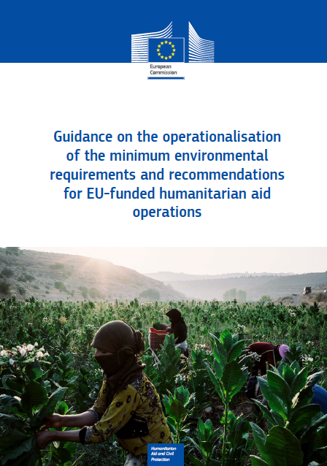
DG ECHO's Environmental Mainstreaming
Context: Integration of environmental considerations in funding and grant processes.
Challenge: Humanitarian actions contributing to deforestation, water contamination, and GHG emissions.
Actions:
    Established environmental requirements for EU-funded operations.
    Implemented Environmental Impact Assessments (EIA) and risk tools like NEAT+.
    Promoted sustainable procurement, renewable energy, and capacity building across sectors.
    Used Environmental Management Systems (EMS) to guide partners.
Source: European Union
Notes:
48

Slide 49
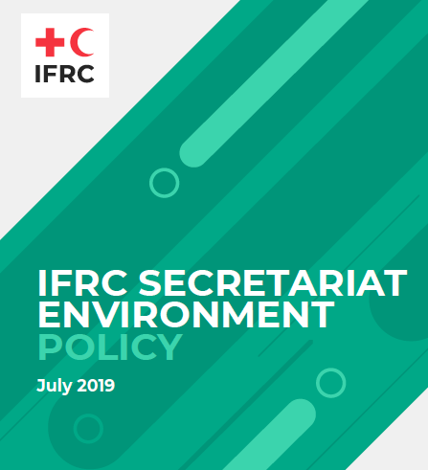
IFRC Environmental Policy
Context: Ensuring humanitarian activities respect the environment through systematic integration.
Challenge: Negative impacts like environmental degradation and increased community vulnerability.
Actions:
      Developed environmental policies integrated into planning and evaluation.
      Applied Environmental Management Systems (EMS).
      Trained staff and developed performance indicators.
      Promoted sustainable waste management and resource use in operations.
Source: IFRC

Slide 50
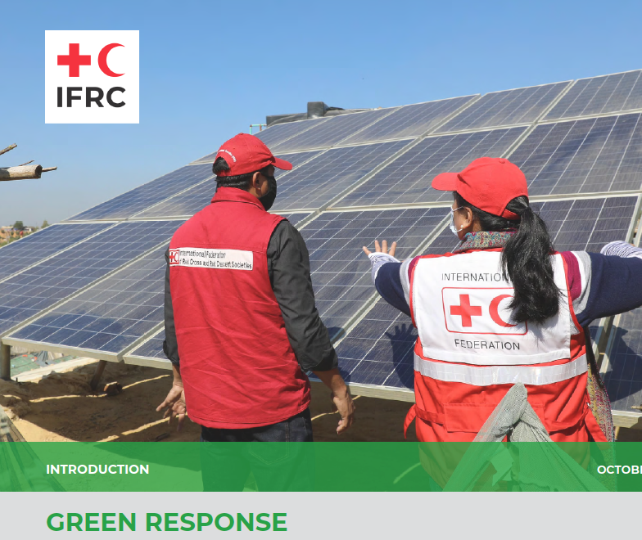
Source: IFRC
Green Response - ICRC
Context: Integrating environmental considerations into humanitarian response and internal practices.
Challenge: Addressing the environmental impact of humanitarian operations and climate change.
Actions:
      Developed climate and environmental strategies.
      Integrated environmental considerations into needs assessments and response systems.
      Created sector-specific technical guidance and trained staff.
      Advocated through the Climate and Environment Charter and contributed to Sphere Standards updates.
Notes:
50

Slide 51
Key Takeaways
Environmental mainstreaming integrates environmental considerations into humanitarian action, reducing the environmental and carbon footprint of operations and supporting sustainable development.
Importance: Enhances sustainability, resilience, and efficiency in humanitarian programs, improving resource use and decision-making.
Entry points & enablers: Key stages include needs assessment, project design, and policy development, supported by leadership, stakeholder engagement, and capacity building.
Environmental policies: Aligning policies with global frameworks like the SDGs and Paris Agreement ensures compliance and impact.
Cluster-specific impacts: Each cluster (WASH, Shelter, Logistics) has unique environmental challenges requiring tailored mitigation strategies.
Financing: Securing funds from donors, grants, and partnerships is critical for sustainable environmental initiatives.
Managing risks: Contingency planning, diversified funding, and financial monitoring safeguard the sustainability of environmental programs.
Partnerships: Strategic alliances and co-funding initiatives reduce financial risks and enhance long-term financing.
Case studies: Successes like the SSCA and DG ECHO show the importance of leadership and collaboration for environmental mainstreaming.
Application: A systematic approach to needs assessment, policy, project design, and monitoring ensures environmental considerations are embedded throughout humanitarian programs.
Notes:
51

Slide 52
Thank you
Any Questions?

